Slide 1
ENVE 201 Environmental Engineering Chemistry 1
Alkalinity
Dr. Aslıhan Kerç

Slide 2
ALKALINITY
Alkalinity : Capacity of a water to neutralize acids.(Acid neutralization capacity)
Alkalinity in natural waters→
Due to salts of weak acids
Weak or strong bases

Slide 3
Major form of alkalinity→ bicarbonates
CO₂ + CaCO₃ + H₂O → Ca²⁺ + 2HCO⁻
Formed with the rxn of CO₂ and basic materials in soil.
Organic acid salts
Salts of weak acid (in anaerobic waters acetic , propionic)
Ammonia

Slide 4
Natural waters may contain carbonate and hydroxide alkalinity.
Algae remove CO₂ → pH 9-10
Boiler waters contain CO₃⁼ and OH⁻ alkalinity
Types of alkalinity in natural waters :
Hydroxide
Carbonate
Bicarbonate

Slide 5
Alkalinity acts as buffer to resist to pH drops
No public health significance of alkalinity
Taste of highly alkaline waters are not good

Slide 6
Methods of Determining Alkalinity
Titration with N/50 H₂SO₄ reported in terms of equivalent CaCO₃.
If pH > 8.3 Titration in two point
First step → till pH 8.3 phenolphthalein turning point ( pink to colorless)

Slide 7
Second step → pH 4.5 Bromcresol green end point or M.O.
@ pH 8.3 CO²⁻₃ + H⁺ HCO⁻₃
@ pH 4.5 HCO⁻₃ + H⁺ H₂CO₃
Alkalinity is the sum of all the titratable bases
0.01 M [HCO⁻₃ ] → 500 mg/L as CaCO₃
10 meq/L * 50 mg/meq = 500 mg/L

Slide 8
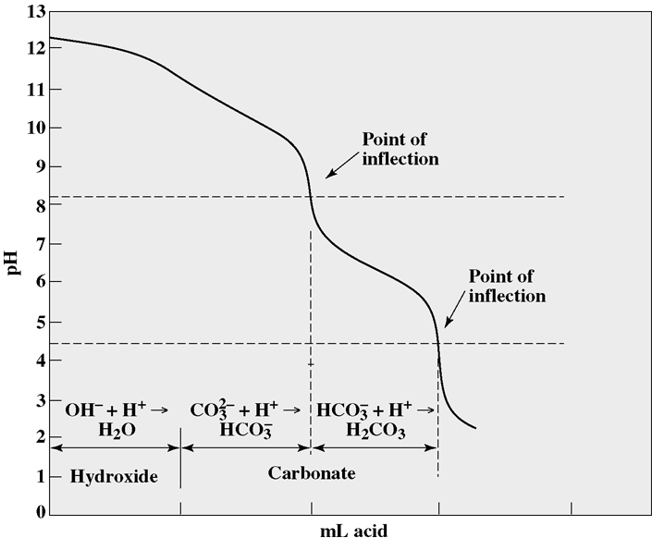
Titration curve for a hydroxide-carbonate mixture.
Figure 18.1

Slide 9
Phenolphthalein and Total Alkalinity
Strong base titration curve
@ pH 10 all the hydroxide ions are neutralized
@ pH 8.3 carbonate converted to bicarbonate
Titration till phenolphthalein end point→ Phenolphthalein alkalinity

Slide 10
Total alkalinity → titration till pH 4.5
Conversion till carbonic acid H₂CO₃
Phenolphthalein Alkalinity =
mL N/50 H₂SO₄ * 1000/mL sample
Till pH 8.3
Total Alkalinity =
mL N/50 H₂SO₄ * 1000/mL sample
Till pH 4.5

Slide 11
Calculate
Hydroxide, Carbonate, Bicarbonate alkalinity
1. Calculation from alkalinity measurements
2. Calculation from alkalinity and pH measurement
3. Calculation from equilibrium equations (carbonic acid)

Slide 12
Calculation from Alkalinity Measurements
Determine pp and total alkalinities.
OH⁻ , CO⁼₃ , HCO⁻₃ calculated→ not exactly
Assumption OH⁻ and HCO⁻₃ cannot exist together

Slide 13
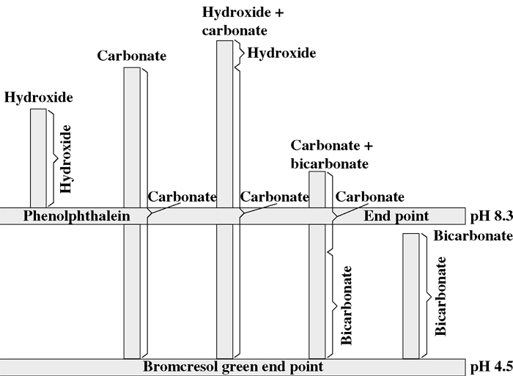
Graphical representation of titration of samples containing various forms of alkalinity.
Figure 18.2

Slide 14
Five possible situations :
Hydroxide only
Carbonate only
Hydroxide and Carbonate
CO⁼₃ and HCO⁻₃
HCO⁻₃
@pH 8.3 neutralization of hydroxides are completed.

Slide 15
Carbonate CO⁼₃ is one half neutralized
2nd phase of titration :
For hydroxide negligible amount of additional acid is required.
For CO⁼₃ , exactly equal amount of acid is required to reach pH 8.3

Slide 16
OH⁻ only : pH > 10
OH alkalinity = Phenolphthalein alkalinity
CO⁼₃ only : pH > 8.5 , V_{t}=2V_{pp}
OH⁻ and CO⁼₃ pH > 10
CO⁼₃ = 2(titration form 8.3 – 4.5)*1000
mL sample
Hydroxide alk. = Total- Carbonate alk.

Slide 17
CO⁼₃ and HCO⁻₃ 8.3 < pH < 11
Carbonate alk. = 2 * (V_{pp}) * 1000
mL sample
HCO⁻₃ = Total- Carbonate alk.
HCO⁻₃ only pH < 8.3
Bicarbonate = Total Alk.

Slide 18
Calculation from Alkalinity + pH Measurements
Measure :
pH
Phenolphthalein alkalinity
Total alkalinity
Calculate OH⁻ , CO⁼₃ and HCO⁻₃

Slide 19
Hydroxide alkalinity → calculated from pH measurement.
[OH⁻ ] = Kw / [H⁻]
1 mol/L = 50000mg/L as CaCO₃
Hydroxide alkalinity = 50000 x 10^{(pH-pKw)}
pK_{w} = 14.00 @ 24 °C

Slide 20
Phenolpht. alk. = Hydroxide + ½ Carbonate
Carbonate alk. = 2 ( pp alk. – hyd. Alk. )
Bicarbonate alk. = Total alk. – (carbonate alk. + hydroxide alk. )
(Titration from pH 8.3 to 4.5)
Remaining ½ carbonate alk.
Bicarbonate alk.

Slide 21
Carbonate Chemistry
H₂CO₃ , HCO⁻₃ , CO⁼₃ , CO_{2 (aq)}
( dissolved in water CO₂ )
X _{CO2} = P _{CO2} / k _{CO2} (Henry’s Law)
Constituents of alkalinity in natural waters.
HSiO⁻₃ , H₂BO⁻₃ , HPO⁼₄ , H₂PO⁻₄

Slide 22
HS⁻ , NH₃ , conjugate bases of organic acids
OH⁻ , CO⁼₃ , HCO⁻₃
H⁺ + HS⁻ → H₂ S
H⁺ + OH⁻ → H₂ O
H⁺ + CO⁼₃ → HCO⁻₃
HCO⁻₃ + H⁺ → H₂CO₃
(2 H⁺ + CO⁼₃ → H₂CO₃ )

Slide 23
Alkalinity and acidity are based on the “carbonate system “ .
[Alk.]=[HCO⁻₃ ] + 2[CO⁼₃ ] + [OH⁻] – [H⁺ ]
( mol/L of H⁺ that can be neutralized)
(Alk.)=(HCO⁻₃ )+ (CO⁼₃ ) + (OH⁻) – (H⁺)
( eq/L of H⁺ that can be neutralized)
Alk. In mg/L as CaCO₃ = ( Alk.) x EW _{CaCO3}

Slide 24
Example :
CO⁼₃ = 20 g/m³ HCO⁻₃ = 488 g/m³
OH⁻ = 0.17 g/m³ Alk. = ?
Ion | MW ( g/mole) | EW (g/eq) | (eq/m³ )
CO⁼₃ | 60 | 30 | 20/30=0.67
HCO⁻₃ | 61 | 61 | 488/61=8
OH⁻ | 17 | 17 | 0.17/17=0.01

Slide 25
[H⁺ ] [ OH⁻ ] = Kw
(OH⁻) (H⁺) =Kw
[H⁺ ] = 10⁻¹⁴ / (0,01x 1/1000 x 1 mol/eq)
= 10⁻⁹ mol/L =10⁻⁹ eq/L = 10⁻⁶ eq/m³
[Alk.]=[HCO⁻₃ ] + 2[CO⁼₃ ] + [OH⁻] – [H⁺ ]
(Alk.)= 8,00 + 0,67 + 0,01 - 10⁻⁶
=8,68 eq/m³
(8,68 x 10⁻³ eq/L) x (50000 mg/eq)=434 mg/L as
CaCO₃

Slide 26
Expressing in terms of CaCO₃
Species A
mg/L as CaCO₃ = ( mg/L A)(EW _{CaCO3} / EW_{A})
Example : 10 mg/L Mg²⁺
Mg⁺² = 24,3 mg/L EW _{Mg+2} = 24,3/2=12,15
Conc of Mg⁺² as CaCO₃
(10 mg/L)x((5000 mg/eq)/(12150 mg/eq Mg⁺²))
= 41,15 mg/L as CaCO₃

Slide 27
Calculation from Equilibrium Equations
Equilibrium eqns
(Acidity and alkalinity are based on carbonate system)
Electroneutrality (charged balance) in sol’n
Equivalent conc. of anions = cations
Total alk. = Alkalinity producing anions – hydrogen ions

Slide 28
[Alk.]=[HCO⁻₃ ] + 2[CO⁼₃ ] + [OH⁻] – [H⁺ ]
( mol/L of H⁺ that can be neutralized)
(Alk.)=(HCO⁻₃ )+ (CO⁼₃ ) + (OH⁻) – (H⁺)
( eq/L of H⁺ that can be neutralized)
Alk. In mg/L as CaCO₃ = ( Alk.) x EW _{CaCO3}

Slide 29
Equilibrium equations :
Dissociation of water [OH⁻] = K_{w}/ [H⁺ ]
Second ionization for carbonic acid
K_{A2} = [H⁺ ] [CO⁼₃ ] / [HCO⁻₃ ]
[H⁺ ] + alkalinity = [HCO⁻₃ ] +2 [CO⁼₃ ] + [OH⁻]
50000

Slide 30
Carbonate alk. = 50000[(alk./50000)+ [H⁺ ] –(Kw/ [H⁺ ] )]
(mg/L as CaCO₃ ) 1+([H⁺ ] /2 K_{A2} )
Bicarbonate alk. =50000[(alk./50000)+ [H⁺ ] –(Kw/ [H⁺ ] )] (mg/L as CaCO₃ ) 1+(2 K_{A2} / [H⁺ ] )
K_{A2} and Kw change with temperature and ionic conc.

Slide 31
CO₂ , Alkalinity and pH relationship
Equilibrium rxns :
CO₂ + H₂ O ←→ H₂CO₃ ←→[H⁺ ] + [HCO⁻₃]
M(HCO⁻₃ )₂ ←→ M⁺ + 2 HCO⁻₃
HCO⁻₃ ←→ H⁺ + CO⁼₃
CO⁼₃ + H₂O ←→ HCO⁻₃ + OH⁻
HCO⁻₃ is involved in all equations.
Change in conc. or pH shift the equilibrium.

Slide 32
pH Changes during Aeration
Aeration→ removes CO₂
CO₂ acidic gas→ removal increase pH
Air content 0,03 % by volume CO₂
Henry ‘s constant : 1500 mg/L.atm
Equilibrium conc.for CO₂ = 0,0003 x 1500
=0,45 mg/L

Slide 33
K_{A1} = [H⁺ ] [HCO⁻₃ ] / [H₂CO₃ ]
If alkalinity = 100 mg/L
Aerated until equilibrium of CO₂ in air
pH=8,6

Slide 34
pH Changes in Algal Blooms
During algal blooms pH 10
Algae use CO₂ in photosynthesis.
Algae can reduce CO₂ conc. below its equilibrium concentrations.
As pH increase alkalinity forms change

Slide 35
2HCO⁻₃ ←→ CO⁼₃ + H₂O + CO₂
CO⁼₃ + H₂O ←→ 2OH⁻ + CO₂
Total alkalinity remains constant
Algae extract CO₂ until pH 10-11
During dark hours algae produce CO₂

Slide 36
Respiration exceeds photosynthetic process
CO₂ production tends to reduce pH
Boiler Waters
CO₂ insoluable in boiling water → Removed with steam →increase pH

Slide 37
Alkalinity shift from
Bicarbonate→ carbonate
Carbonate→ hydroxide
When there is OH⁻ alk. pH is high pH=11

