Slide 1
BIOCHEMICAL OXYGEN DEMAND

Slide 2
BIOCHEMICAL OXYGEN DEMAND (BOD)
BOD the amount of oxygen required by bacteria while stabilizing decomposable organic matter under aerobic condition.
Organic matter serve as food for bacteria
Organic matter
Energy +
oxygen

Slide 3
BOD test→used to determine pollutional strenght of domestic and industrial wastes in terms of oxygen that they will require if discharged into natural watercources
wastewater
DO
O2
Org. matter

Slide 4
BOD test
  Bioassay procedure.
  Measures oxygen consumed by living organisms while utilizing organic matter present in waste.
Conditions → as similar as possible to those that occur in nature
To be quantitative → protect from the air to prevent reaeration.
Env. conditions should be suitable for m.o.
No toxic substance.

Slide 5

D.O should be present throughout the test.
O2 solubility~9 mg/L
DO used ~ amount of organic
in sample
Strong wastes must be diluted

Slide 6
All necessary nutrients needed for bacterial growth. (N,P, trace elements)
Diverse group of m.org. (seed) carry the oxidation to CO₂
BOD test → a wet oxidation process
Living organisms serve as the medium for oxidation of org. matter to water and CO₂

Slide 7
Oxygen requirement to convert org. compound to CO₂ , water , ammonia.
C_{n}H_{a}O_{b}N_{c} + ( n + a/4 - b/2 – 3c/4 ) O₂ →
nCO₂+ (a/2 – 3c/2)H₂O+ cNH₃
Temperature effects are held constant by performing the test at 20C
Notes:
Org matter=BOD
O2 equivalent of org matter

Slide 8
İnfinite time is required for complete biological oxidation of organic matter
Practically the reaction considered complete in 20 days =>BOD ultimate
Large percentage of the total BOD is exerted in 5days
The test has been developed on the basis of a 5-day incubation period.=> 5 day BOD
5 day test was selected also to minimize interference from oxidation of ammonia.
Notes:
5 day BOD is not the total BOD!!

Slide 9
BOD Reaction Kinetics
First order rxn kinetics → Rxn rate proportional to the amount of oxidizable organic matter remaining at any time.
(If mo population is nearly constant)
-dc /dt ˜ C
-dc/dt = k’C
C: Conc. of oxidizable org matter
K: rate constant
Rate decreases as C decreases

Slide 10
In BOD considerations;
C→ L (ultimate demand)
-dL/ dt=k’L
Lt/L = e^{-k’t}
Lt=L* e^{-k’t}
e^{-k’t} = 10^{–kt}
k=k’/ 2.303

Slide 11
k’ : BOD rxn constant (d⁻¹). Typically k’ ˜0.1 to 1 d⁻¹ for degradable org. matter in natural water at ambient temp 10 < T < 30 °C
BOD _{t} = L (1-10^{–kt} )
BOD _{t} : BOD at any time t,
L: BOD ultimate

Slide 12
The oxygen consumed in the time interval from zero to t is called BOD _{t}
BOD _{t :} BOD consumed within time t
Lt : Potential BOD remaining at time t
BODt = L –Lt = L – L. e^{-k’t}
      = L (1- e^{-k’t} )

Slide 13
Example 1: Determine 1 day BOD and ultimate BOD for a wastewater whose 5 day , 20 °C BOD is 200 mg/ L.
The reaction constant k ( base e) = 0.23 d⁻¹

Slide 14
Its possible to determine reaction constant k at a temp. other than 20 °C.
Vant Hoff – Arrhenius relationship :
K_{t} = k₂₀ Ɵ ^{( t-20)}
Ɵ = 1,056 (20<T<30 °C)
Ɵ = 1,135 ( 4<T<20 °C)

Slide 15
Example 2: Calculate rate constant for T=24C
k=0.23 d⁻¹ (@ 20C)
Ɵ=1.047

Slide 16
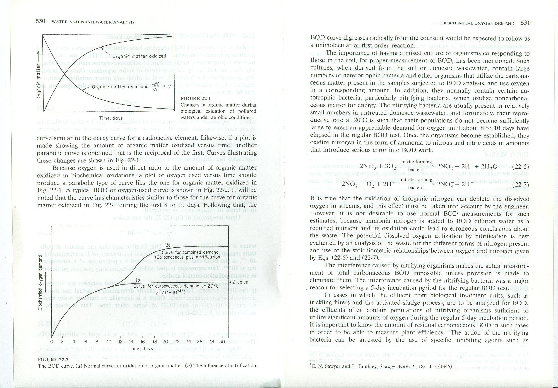
Oxygen used → Organic matter oxidized ( Direct Ratio)
~ Oxygen used

Slide 17
Influence of Nitrification on BOD
BOD or oxygen-used curve is similar to organic matter oxidation curve during the first 8-10 days.
For proper measurement of BOD, cultures used in BOD test should contain heterotrophic bacteria and other organisms that utilize the carbonaceous matter.

Slide 18
Additionally they contain certain autotrophic bacteria, particularly nitrifying bacteria.
    nitrifying bacteria oxidizes noncarbonaceous matter for energy
Nitrifying bacteria present small amounts in untreated domestic ww.
@20 °C their populations do not become sufficiently large to exert oxygen demand until 8-10 days.
Interference of nitrification eliminated by taking test period 5 days → BOD ₅

Slide 20
Untreated domestic ww contains little amount of nitrifying bacteria, but effluent from biological treatment units such as Activated sludge and Trickling filter do contain nitrifying bacteria that can also consume D.O. in 5 days.
Inhibit the action of nitrifying bacteria by specific inhibiting agents 2-Chloro-6 ( trichloromethyl) pyridine (TCMP) or Allylthiourea (ATU).

Slide 21
BOD Test
Method is based on determination of D.O.
Direct method Dilution method

Slide 22
Direct Method :
If BOD ₅ < 7 mg/L → no dilution required.
Ex: River waters
Adjust the sample to 20 °C , aerate with diffused air to increase or decrease dissolved gas content to near saturation.
Fill BOD bottles. Measure D.O. İmmediately in first bottle.
Incubate 5 day → Measure D.O. → BOD =DO1-DO2

Slide 23
Dilution Method
Rate at which oxygen is used in dilution of wastes is in direct ratio to percent of waste in dilution.
10% dilution uses oxygen at 1/10 the rate of a 100% sample.

Slide 24
Control all environment conditions in the bioassay test.
Free of toxic materials
Favourable pH and osmotic cond.
Presence of available nutrients
Standard Temp.
Presence of mixed organisms of soil origin

Slide 25
Industrial wastes may be free of m.org. And nutrients
Domestic ww→ Contain org. Nutrients N, P,
Dilution water used in BOD must compensate these deficiences.
Dilution water
Natural surface water
Tap water=>possibility of toxicity from chlorine residuals.
Synthetic dilution water prepared from distilled, demineralised w.***the best
Dilution water must be free of toxic subs. Chlorine, Chloroamines, copper.

Slide 26
Seeding: (maintain necessary microorganism)
Domestic wastewaters
Blank (dilution water)
Diluted sample
Seed
Nutrient
pH buffer
Nitrification inhibitor
Dilution water

Slide 27
Dilutions of wastes
Set three dilutions
If strenght is known→ two dilutions
Some cases→up to 4 dilutions
Samples should deplete at least 2 mg/L D.O.
At least 0.5 mg/L of D.O. remaining at the end of incubation.
DO1-DO2=2-7 mg/L

Slide 28
Example 3: Calculate the percentage of waste should be added to a BOD bottle if the BOD range is;
Range, mg/L | % sample
200-700
40-140
20000-70000
200/2=100
100/100=1 %
40/2=20
100/20=5 %
20,000/2=10,000
100/10000=0.01%

Slide 29
Incubation bottles:
Glass stoppers
Prevent air trapping during incubation
    Water seal.
Bottles should be free of organic matter.
Clean with chromic acid or detergent.
Rinse carefully
All cleaning agents removed from bottle
  4 rinse with tap water,
  final rinse with Distilled or deionized water

Slide 30
Calculation of BOD
BOD(mg/L)=
DOb=DO found in blank at the end of incubation
DOi=DO found in diluted sample at the end of incubation
DOs= DO that originally present in undiluted sample

Slide 31
Example 4: Calculate BOD concentration in mg/L
DOb | 7
V sample | 2
V bottle | 300
DOi | 2
DOs | 4

Slide 32
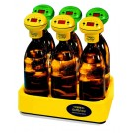
Respirometric measurement
OXYTOP
Respirometric method:Respirometric methods provide direct measurement
of the oxygen consumed by microorganisms from an air or
oxygen-enriched environment in a closed vessel under conditions
of constant temperature and agitation.

Slide 33
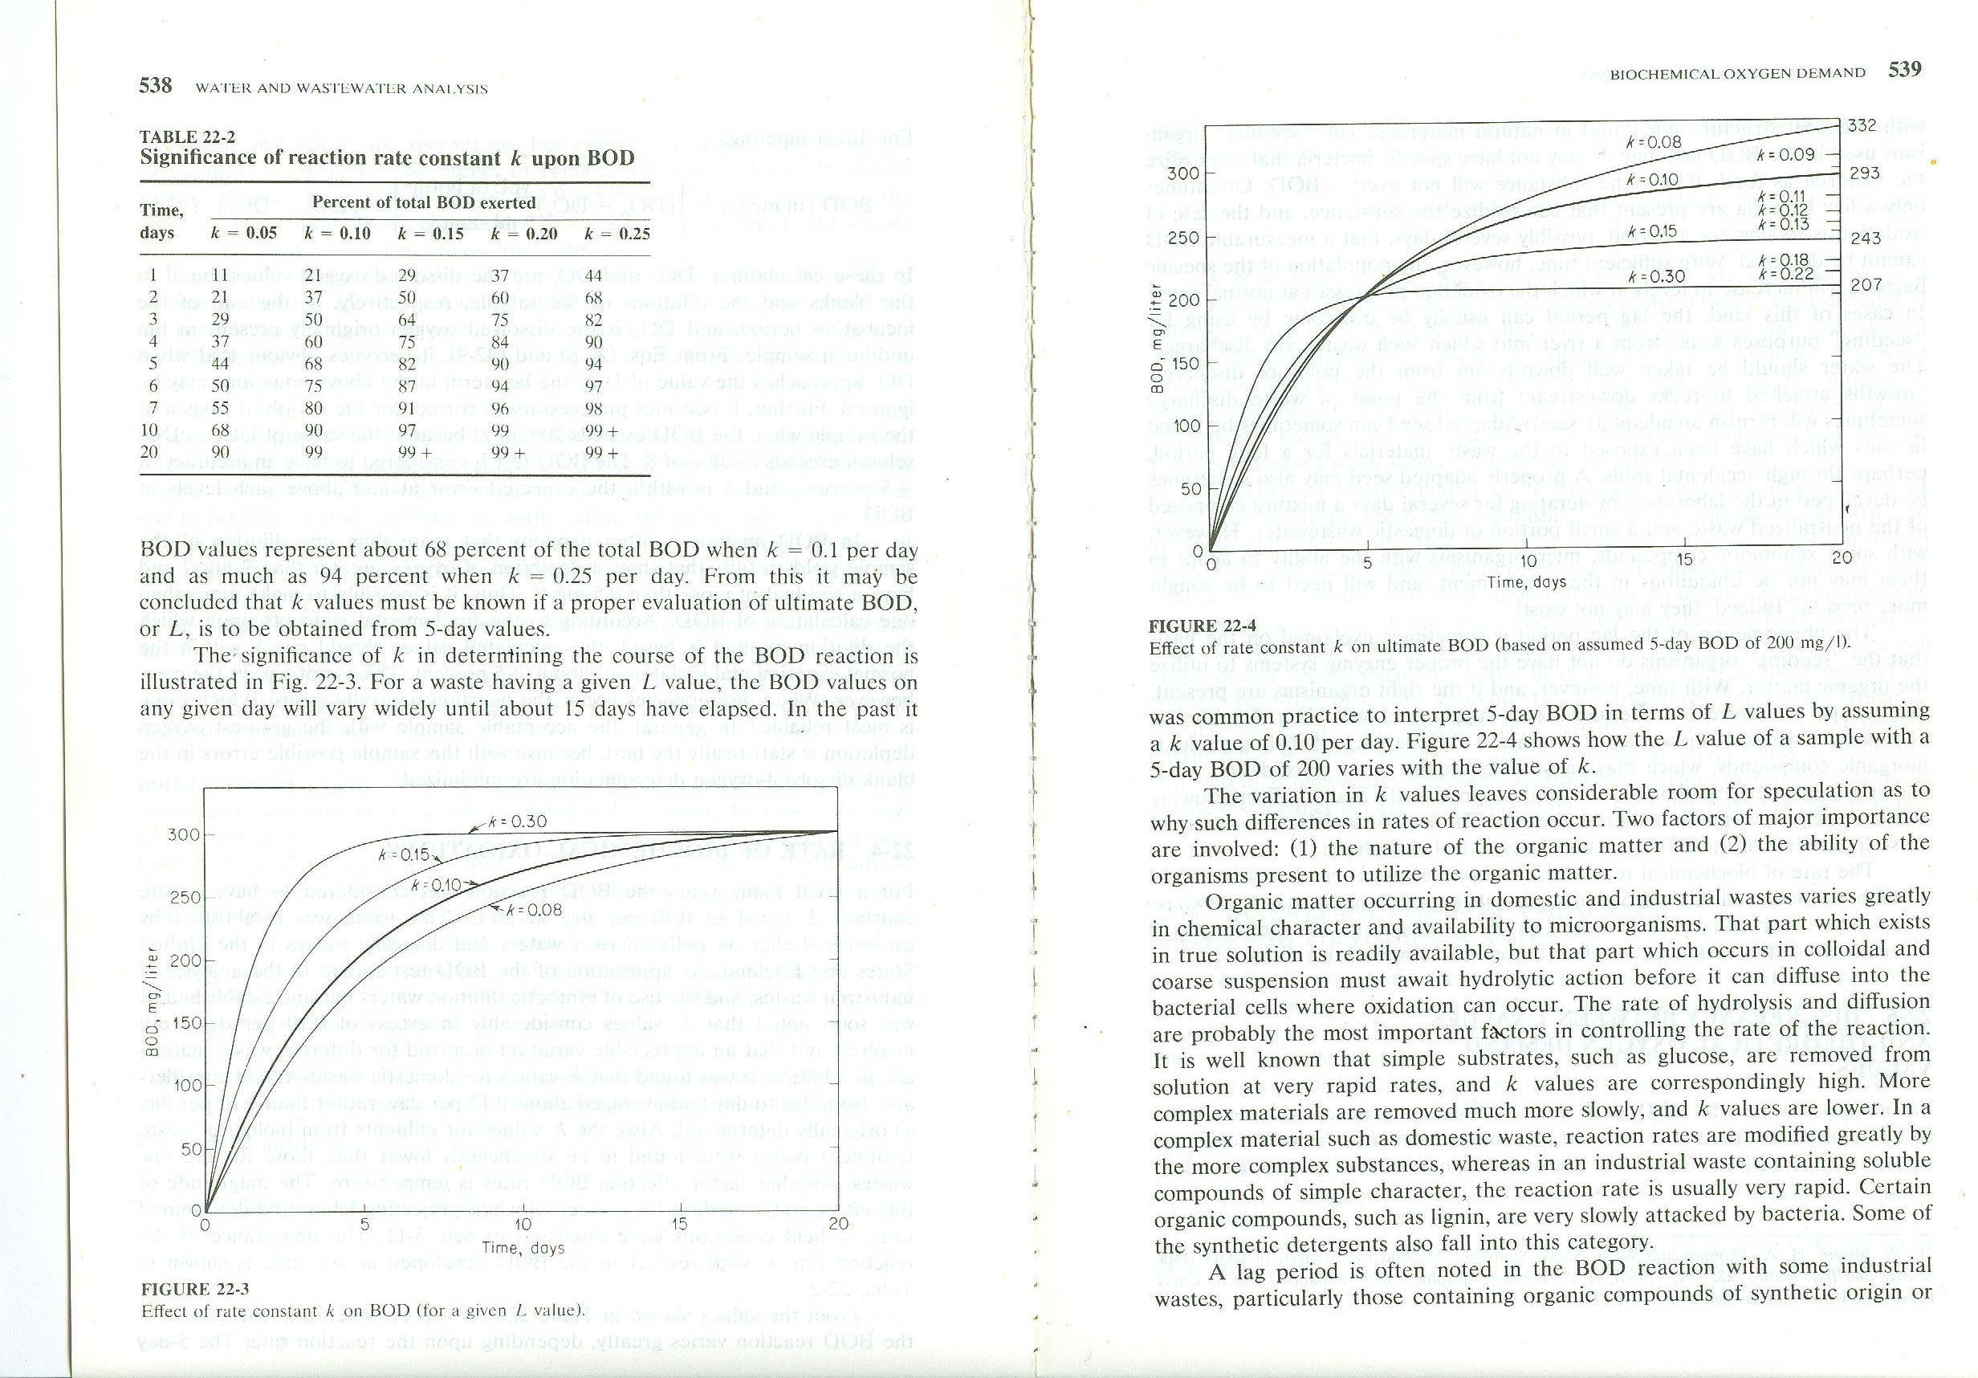
Rate of Biochemical Oxidations
Differs in diff. Wastes

Slide 36
Effluent from bioligical wwtp different from raw wastes
  Nature of the org. Matter
  The ability of the organisms present to utilize the org. Matter
  Rate of hydrolysis and diffusion
Ex: Glucose→ high k
Lignin, Synthetic detergents
→ slowly attacked by bacteria

Slide 37
BOD_{L} and Theoretical Oxygen Demand
Total BOD or L = ThOD considered to be equal
Oxidation of glucose
C₆H₁₂O₆ + 6O₂ → 6CO₂+ 6H₂O
180 192

Slide 38
192 g O₂ /mole of glucose
OR
1.065 mg O₂ /mg glucose
300 mg/L of glucose→ ThOD=
Experimentally;
BOD measurements (20 day)
BOD(L)= 250-285 mg/L
85% of theoretical amount
Not all the glucose converted to CO₂ and water
300*192/180=320 mg/L

Slide 39
Org. Matter → Food material →
  Energy
  Growth
  Reproduction
Part of org. Matter → Converted to cell tissue
Cell tissue will remain unoxidized→till endogeneous respiration
  When bacteria die they become food material for others.
  Further transformation to CO₂ , H₂O and cell tissue
  Living bacteria + Dead ones → Food for higher organisms → Protozoans

Slide 40
A certain amount of organic matter remains in these transformations.
Resistant to further biological attack.
Humus→ amount of org. matter corresponding to discrepancy between total BOD and ThOD.

Slide 41
Analysis of BOD Data
Calculation of k value is needed to obtain L using BOD₅.
k and L are determined from a series of BOD measurements.
Methods:
Least squares
Thomas Method
Methods of moments
Daily-difference method
Rapid ratio method
Fujimoto Method

Slide 42
Least squares method:
Fitting a curve throug a set of data points. Sum of the squares of the residual must be minimum. (Difference between observed and the fitted value)

Slide 43
dy/dt (t=n) = k (L-y_{n} )
For the time series of BOD measurements on the same sample Eqn. May be written for each of the various n data points.
k and L → unknown

Slide 44
If it is assumed dy/dt represent the slope of the curve to be fitted through all data points for a given k and L value, two sides will not be equal because of experimental error.
Difference → R
R=k(L-y)-dy/dt
R=kL-ky-y’
a=kL -b=k
R=a+by-y’

