Slide 1
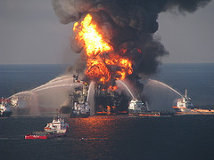
Crude Oil and the Environment
ENVE 202
Dr. A. Kerç

Slide 2
Oil pollution at sea:
Deliberate discharges from ships
Ships colliding or running around
Blow out and explosions on oil rigs
Fractures in underwater pipelines
Variety of technique to clean up oil from coastal environments

Slide 3
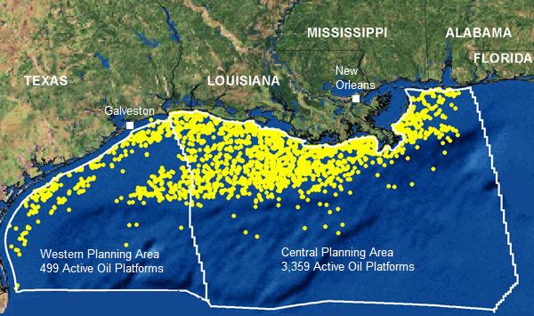
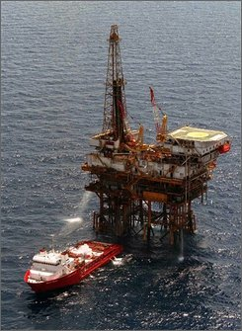
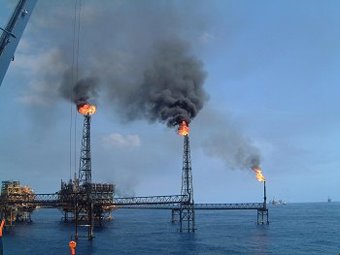
Oil platforms in Gulf of Mexico

Slide 4
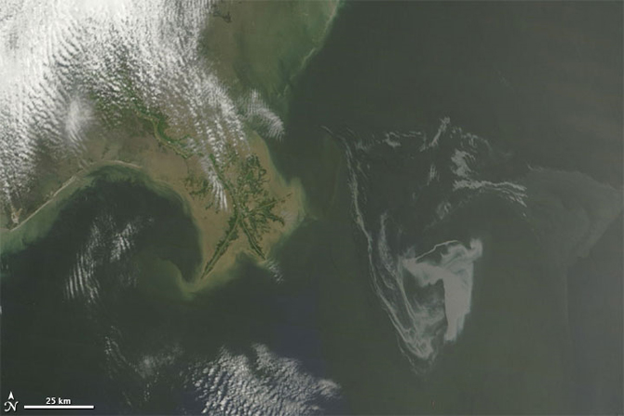
The Deepwater Horizon oil spill (appearing as a dull gray color) is southeast of the Mississippi Delta in this May 1, 2010, image from NASA's MODIS instrument. Credit: NASA/Goddard/MODIS Rapid Response Team

Slide 5
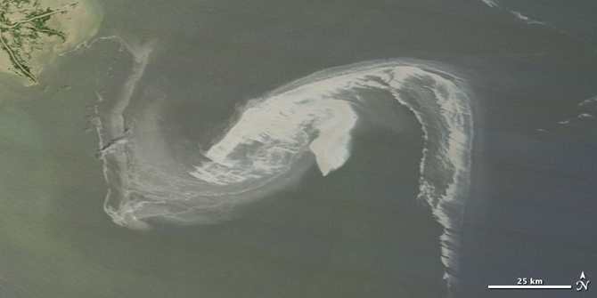

Slide 6
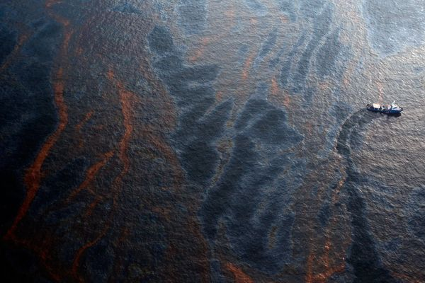
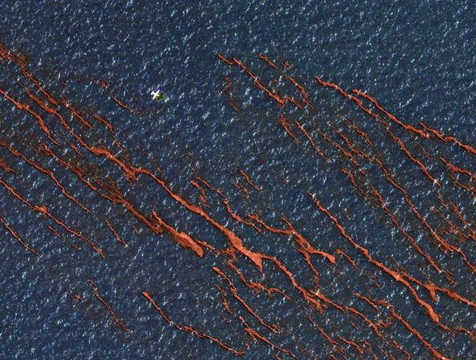

Slide 7
Manual Recovery of oil on land:
* Digging the oil off the beach and placing in containers for later removal and disposal
* In Wales 1996 (Sea Empress): high-pressure hoses were used to clean the oil off rocks and beaches into specially created pits. Collected oil, pumped into tankers.
* Large digger trucks
mechanically scrape oil off the beaches

Slide 8
Chemical Processes:
Heaviest areas of oil slick at sea
→sprayed with a dispersant from an aircraft
Dispersants → speed up the natural process of emulsification of oil in the water
* If oil is at sea > 48 hours
Dispersant not very effective. Can cause chemical damage to the environment

Slide 9
Barriers to the movement of oil:
* Barriers to deflect the oil away from sensitive areas such as beaches or salt marshes.
Collect oil using V-shaped booms.
* Wind, waves and sea current can allow oil to escape under or over the boom

Slide 10
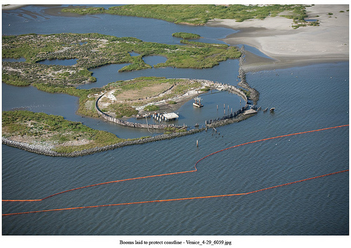
VENICE, La. - Containment boom is staged at the Breton National Wildlife Refuge, Thursday, April 29, 2010. As of Friday, April 30, 2010, over 217,000 feet of containment boom is used to help minimize the impact on environmentally sensitive areas.

Slide 11
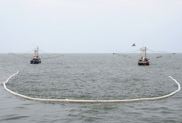
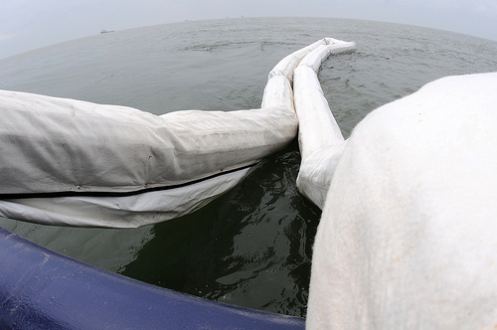
GULF of MEXICO - Fire-resistant oil-containment boom hangs over the stern as the crew aboard the motor vessel Poppa John train to deploy it off the coast of Venice, La., May 3, 2010. The crew is being trained to deploy the boom and pass it along to shrimp boats whose captains have been trained to tow it during an in situ burn.

Slide 12
Mechanical Recovery of oil at sea:
* Oil can be removed from the surface of water by skimming the slick using a moving drum, belt or disc.
* Ships → large suction pumps and settling tanks

Slide 13
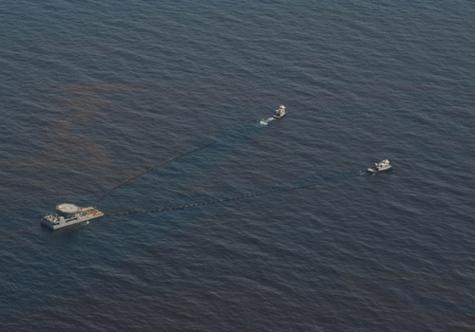
GULF of MEXICO - A high volume skimming system (VOSS) skims oil from the Gulf of Mexico near Venice, La. April 28, 2010. Approximately 76 vessels are responding to the Deepwater Horizon incident oil spill. U.S. Coast Guard photograph by Petty Officer 2nd Class Prentice Danner

Slide 14
Other techniques:
Burning
Sinking → increasing the density of oil by adding chalk or sand and allow it to settle to the seabed.
Gelling →increasing the thickness of oil to reduce the speed at which the slick spreads
Bioremediation → use of microorganisms to degrade the oil
Absorption on nylon ‘’fur’’ and then squeezed out of the fur for reuse and disposal

Slide 15
Modern life style → manufacture or production of many poorly degradable materials
Enter into the environment:
- At the point of production
- During transportation
- Subsequent to their use
Petroleum (=Oil) and petroleum products are in this category.
Oil →Consists of aliphatic hydrocarbons depending on its origin, it can also contain alicyclic and aromatic HC. Oxidized compounds such as aldehydes, ketones and carbonic acids

Slide 16
Oil enter in the environment:
Oil well drilling
Tanker accidents during transportation
Breaks in pipelines
Discharge of water ballast
Refinement of the raw material
Removal of old oil
Drain oil from tankers, motor vehicles and machines

Slide 17
Since hydrophobic oil forms a thin film on the water surface.
1L of a thin mineral oil can spread to make 1x10⁶ L of water unusable.
Biodegradation →slow
* Water-oil emulsion inhibits exchange of gases between water and air
* Oil adhere feathers of sea birds

Slide 18
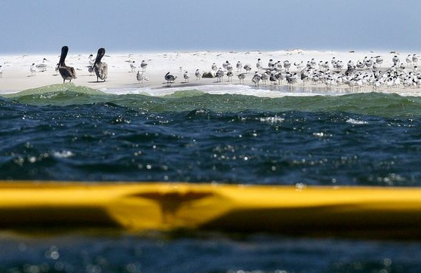
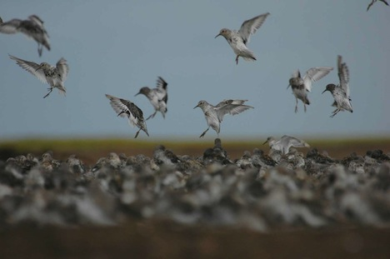

Slide 19
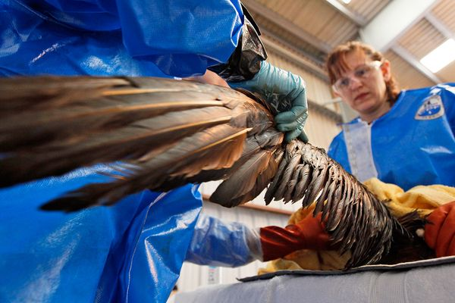

Slide 20
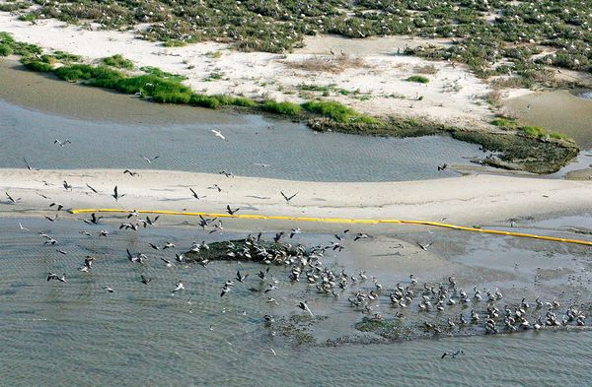

Slide 21
* 2/3 of world’s known ultimately recoverable reserves are in the Persian Gulf Area
*Total affective lifetime of world reserves:
70-80 years

