Slide 1
SULFUR AND SULFATE
ENVE 202
Dr. A. Kerç

Slide 2
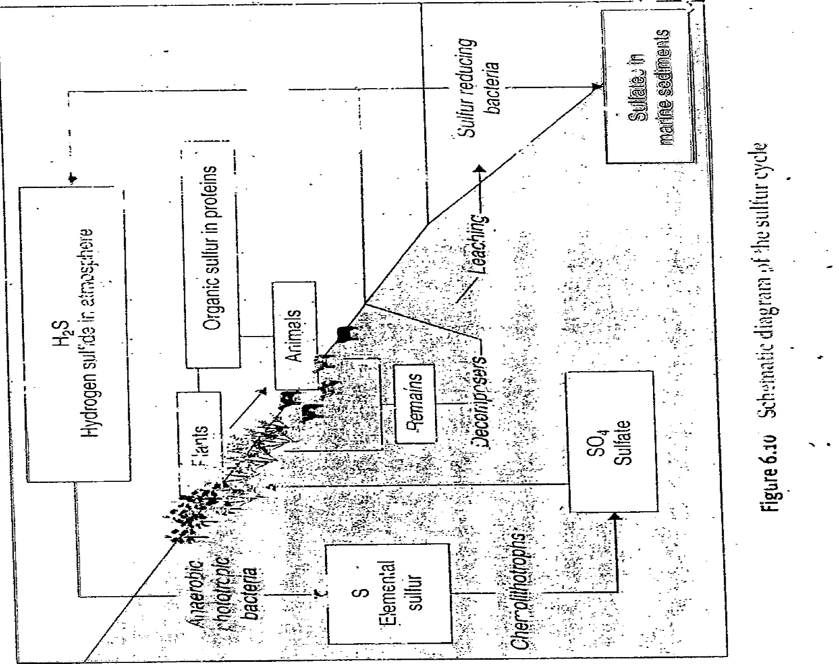

Slide 3
SULFATE
One of the major anions occuring in natural waters
Cathartic effect→ müshil etkisi
Upper limits → 250 mg/L

Slide 4
SULFATE (continue)
Important for public + industrial water supplies → due to tendency of water to form scaling in boilers and heat exchangers
Two serious problems in ww.→Odor
→sewer corrosion

Slide 5
SULFATE (continue)
Reduction of sulfates to hydrogen sulfide under anaerobic condition
SO₄⁻² + org.matter S⁻² + H₂O + CO₂
S⁻² + H⁺ → HS
HS⁻ + H⁺ → H₂S
(Primary ionization cons. K_{A1} = 9.1x10⁻⁸ )
Anaerobic bact

Slide 6
SULFATE (continue)
In biochemical oxidation ( for anaerobic ) if DO and NO₃⁻ do not exist, sulfates serve as oxygen source (electron acceptor)
Relationships between H₂S, HS⁻ , S⁻² are pH dependent

Slide 7
SULFATE (continue)
If pH > 8 HS⁻ and S⁻² [(H₂S) is small] → no odor problem
If pH < 8 equilibrium shift right → @pH 7 80% H₂S
If concentration > 20 ppm toxic

Slide 8
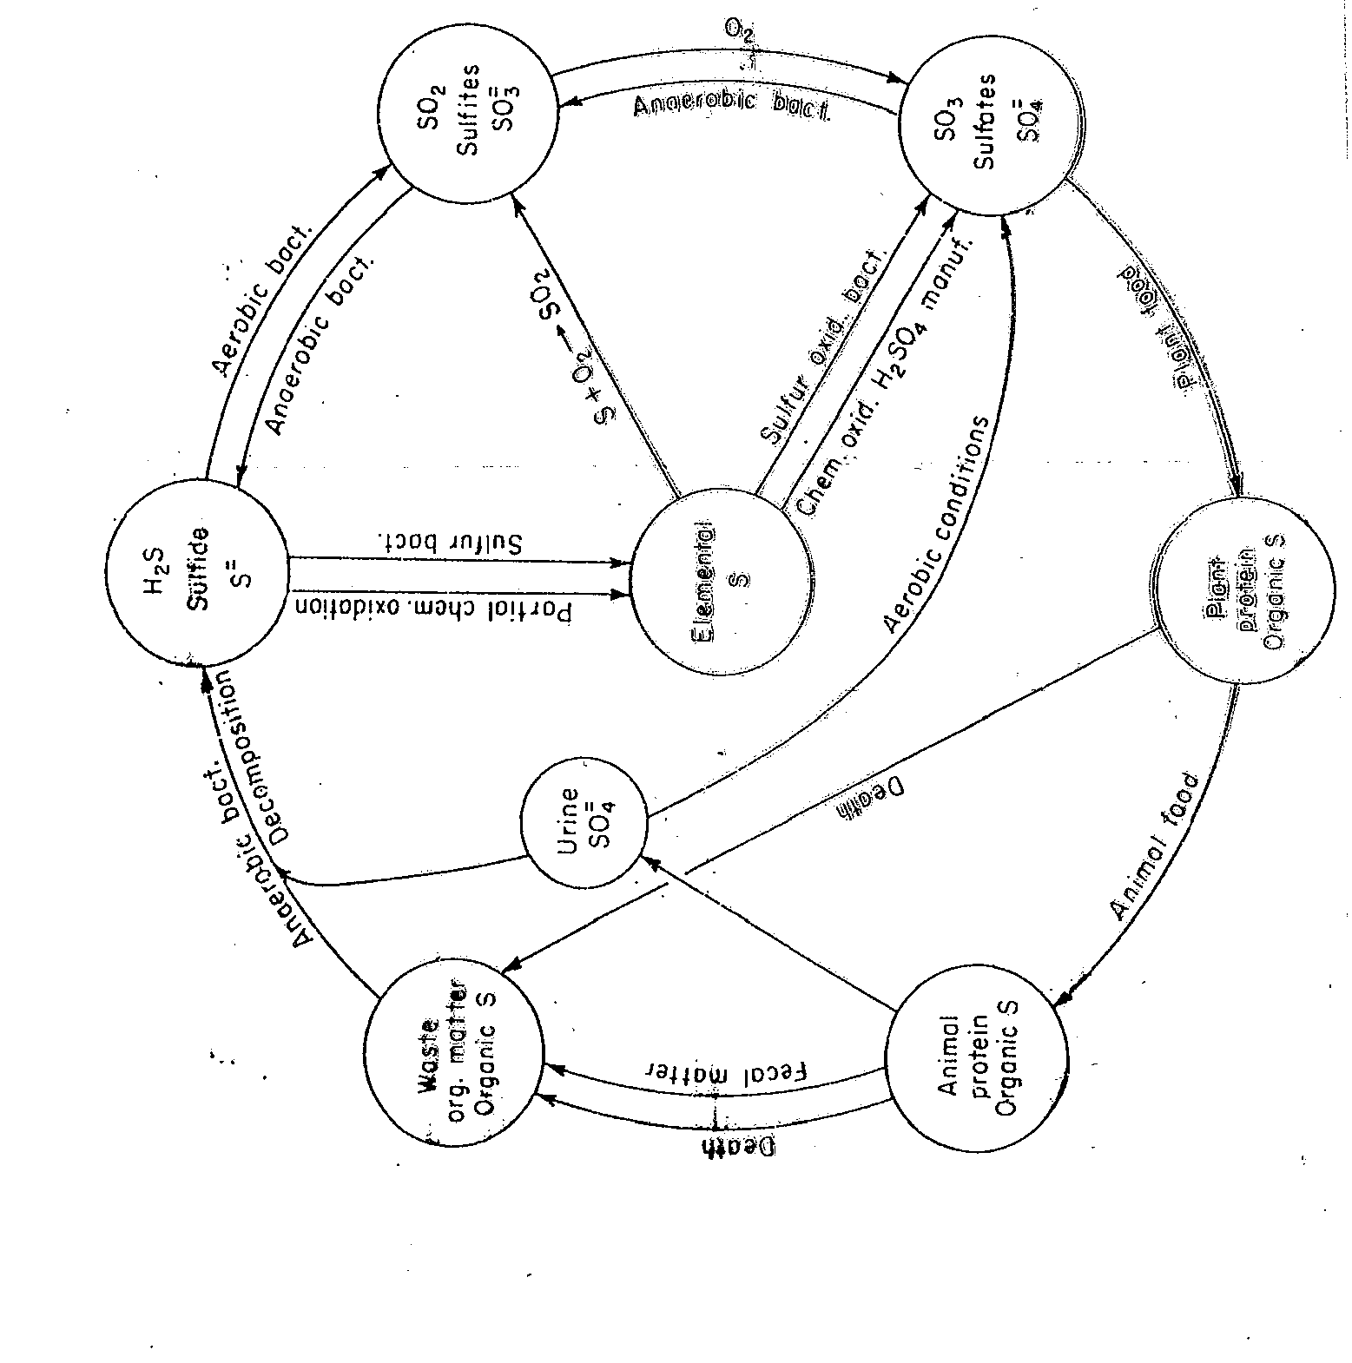

Slide 9
Sewer Corrosion
High temperature, long detention times→sulfate cause crown corrosion in concrete sewers
H₂S responsible (indirectly) for crown corrosion
H₂S is weaker than carbonic acid→ little effect on good concrete

Slide 10
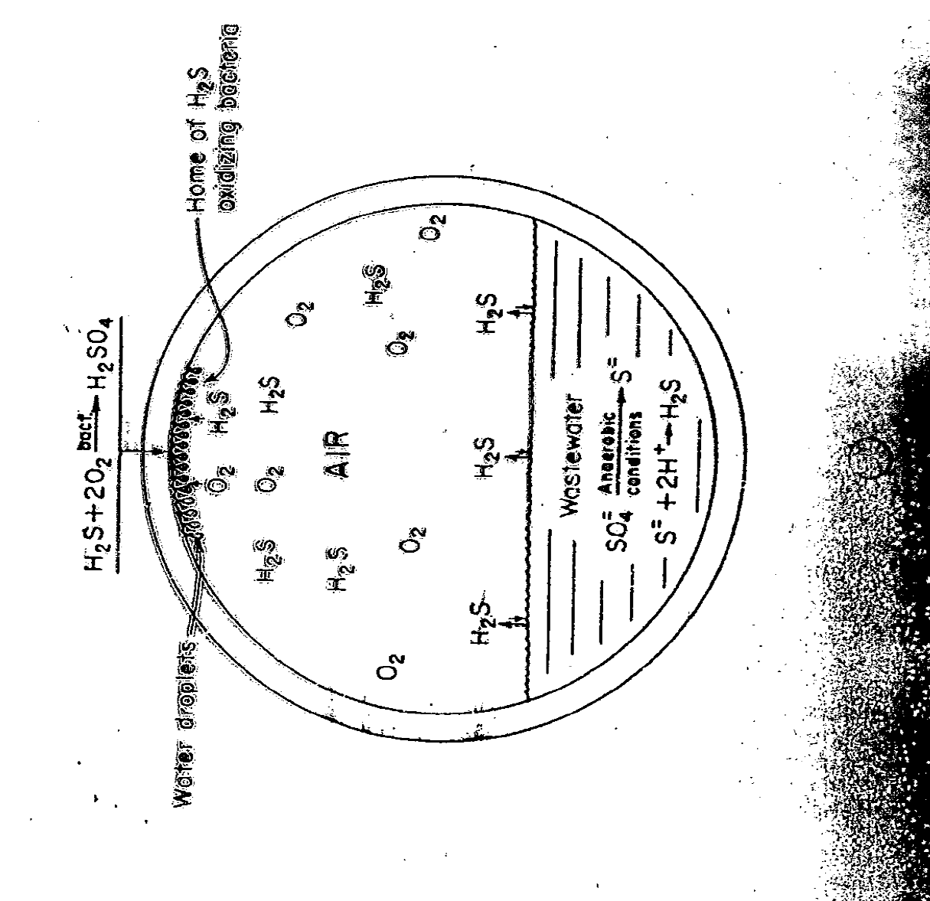

Slide 11
Sewer Corrosion (continue)
Gravity sewers provide unusual environment
Biological changes occur during transportation→require oxygen
If well vent. no problem
H₂S + O₂ → H₂SO₄

Slide 12
Methods of Analysis
Ion chromatograph
Formation of insoluable BaSO₄
According to the quantity of BaSO₄ formation
Gravimetric → precipitate is weighed
Turbidimetric
Methylthymol blue method

Slide 13
Methods of Analysis (continue)
Gravimetric : > 10 mg/L
Ba⁺² + SO₄⁻² → BaSO₄
Add BaCl₂ in slight access
Acidify w/HCL → eliminate BaCO₃ ppt
Keep near boiling point

Slide 14
Methods of Analysis (continue)
Excess BaCl₂ → common ion effect
Formed BaSO₄ → colloidal form can not be removed by filter
Digestion @ temperature near boiling point → crystalline forms
Filter the crystals with special filter

Slide 15
Methods of Analysis (continue)
Turbidimetric :
Colloidal formation is enhanced in the presence acidic buffer solution
(Magnesium chloride, potassium nitrate, sodium acetate, acetic acid)
Calibration curve

Slide 16
Methods of Analysis (continue)
Automated Methylthymol Blue
Continuous flow analytical instrument
BaCl₂ added @low pH→ BaSO₄
pH adjusted to 10
Methylthymol blue added

Slide 17
Methods of Analysis (continue)
Combines with excess Barium → blue chelate
Umcomplexed methylthymol blue remaining → grey color (automatically measured)

