Slide 1
Intro to Web Application Security

Slide 2
Francis Al Victoriano
iHostCodex Web Services
- CEO
Project-AG
– CoFounder
OWASP Panay
-Chapter Leader
-Web Application Pentester
-Ethical Hacker
-Web Developer

Slide 3
The Web Apps
Multimedia
Email System
Search Engine
Online Banking
Online Shopping
Social Network

Slide 4
Typical Web Setup
Apache
IIS
Nginx
MariaDB
PostgreSQL
HTTP
(cleartext)
or HTTPS
PHP
PERL
Client
PYTHON
OS/Web Server
Database Server
Custom
Code

Slide 5
What is WebAppSec?
Simply, Web Application Security
is...
“The securing of web applications”

Slide 6
Why we need Security?

Slide 7
Essentials Terminologies
Threat
An action or event that has the potential to compromise and/or violate security
Vulnerability
Existence of a weakness, design, or implementation error that can lead to an unexpected, undesirable event compromising the security of the system
Exploit
A defined way to breach the security of an IT system through vulnerability

Slide 8
Technical/Business Impact
Compromised
Information Leakage or Lost
Reputational Damage
Money Lost

Slide 9
Common Web Vulnerabilities
1
2
Injection
XSS (Cross Site Scripting)
3
Cross Site Request Forgery

Slide 10
Injection
Injection
Injection flaws, such as SQL, OS, and LDAP injection occur when untrusted data is sent to an interpreter as part of a command or query.
Impact
Injection can result in data loss or corruption, lack of accountability, or denial of access.Injection can sometimes lead to complete host takeover.
Threat
Consider anyone who can send untrusted data to the system, including external users, internal users, and administrators.

Slide 11
SQL Injection Example
SELECT user_id
FROM user_data
WHERE user_name = '' or 1=1
--' AND user_password = '1234';
// …
String query = "SELECT user_id FROM user_data WHERE "
+ user_name = '" + req.getParameter("user") +
"' AND user_password = '" + req.getParameter("password") +"'";
// …

Slide 12
Prevent Injection
Encode all user input before passing it to the interpreter. (White List Validation)
Use an interface that supports bind variables
Always minimize database privileges to reduce the impact of a flaw

Slide 13
XSS (Cross Site Scripting)
XSS
XSS flaws occur whenever an application takes untrusted data and sends it to a web browser without proper validation or escaping.
Impact
Attackers can execute scripts in a victim’s browser to hijack user sessions, deface web sites, insert hostile content, redirect users, hijack the user’s browser using malware, etc.
Threat
Consider anyone who can send untrusted data to the system, including external users, internal users, and administrators..

Slide 14
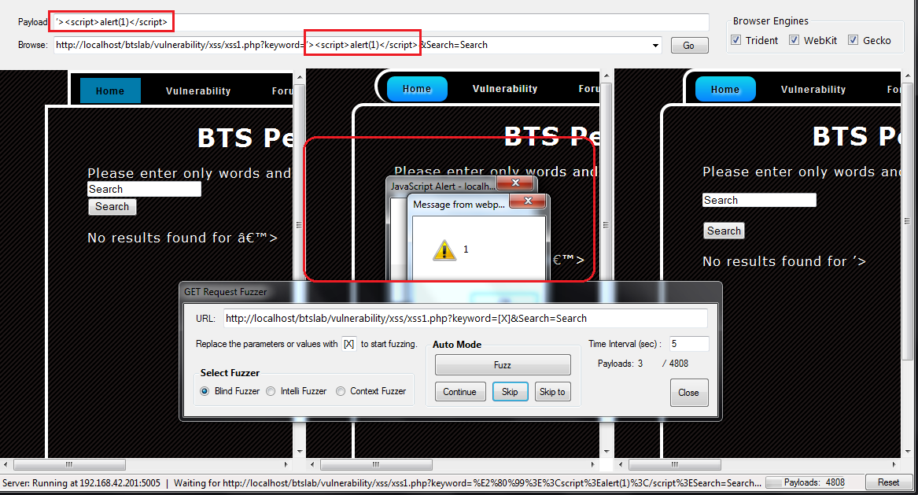
Reflected XSS
Browser
Server
Database
Bug!
URL
Web Application
Victim Request
Website
HTML
Server Response

Slide 15
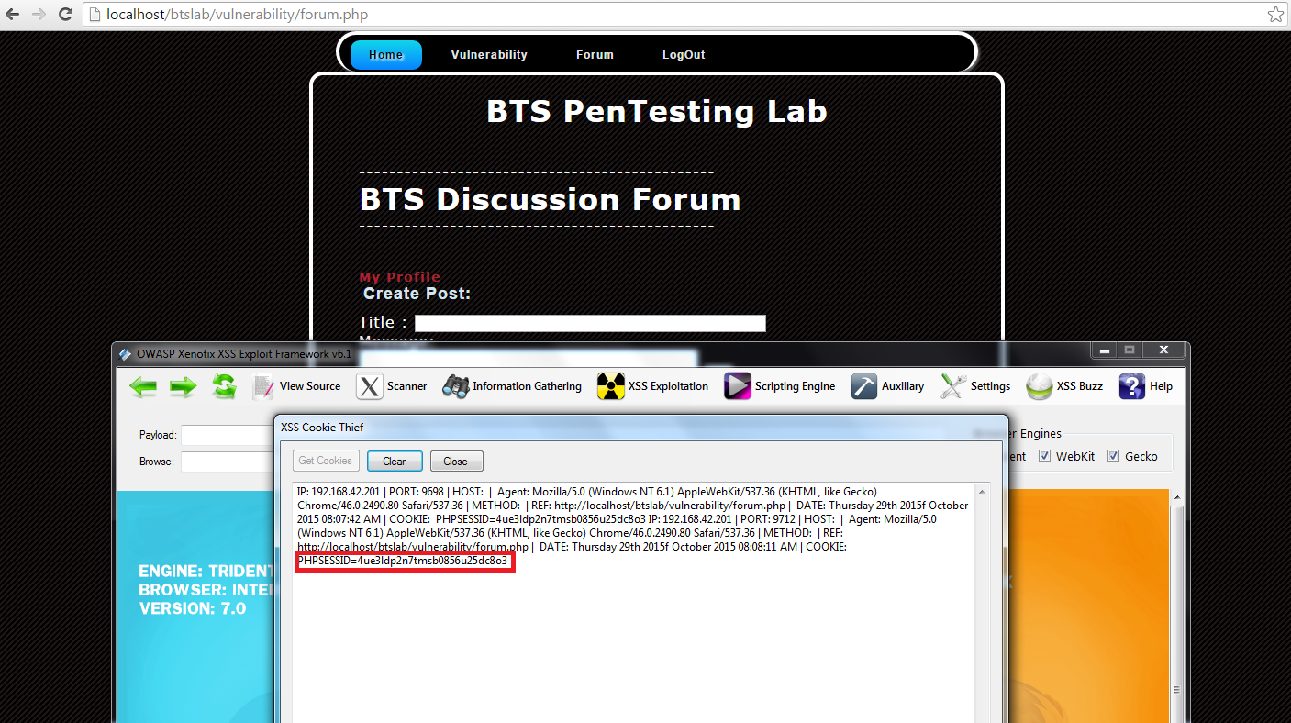
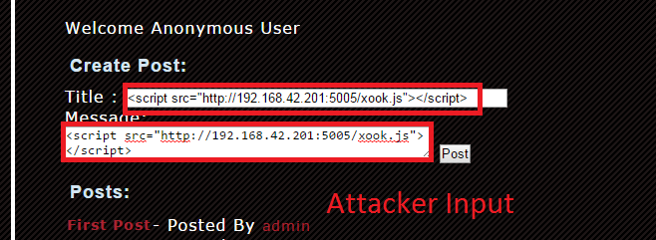
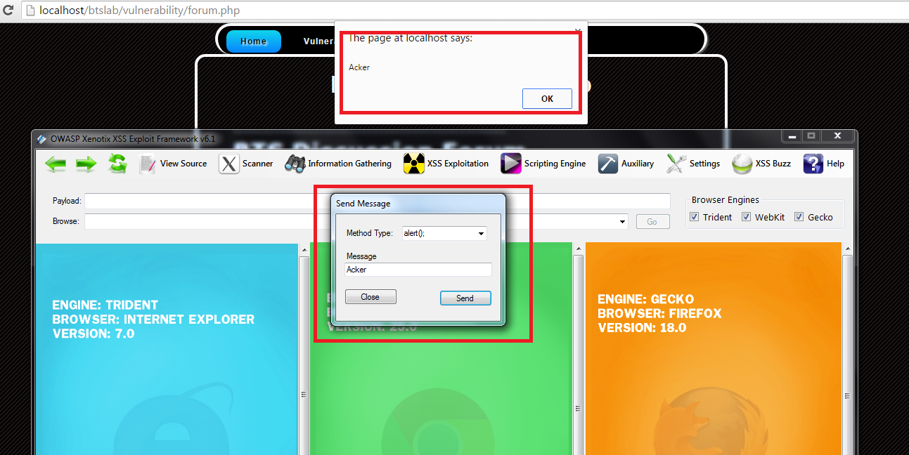
Persistent XSS
Browser
Server
Database
URL
Initial Request
Bug!
URL
Web Application
Subsequent Victim Request
Website
HTML
Server Response

Slide 16
XSS Pattern
Simple Patterns
<SCRIPT>javascript:alert('XSS');</SCRIPT>
<IMG SRC=javascript:alert('XSS')>
<IFRAME SRC="javascript:alert('XSS');"></IFRAME>

Slide 17
Prevent XSS
Don‘t include user supplied input in your output!
Output Encode all user supplied input
Perform White List Input Validation on user input

Slide 18
Cross Site Request Forgery (CSRF)
Cross Site Request Forgery
Impact
Attackers can trick victims into performing any state changing operation the victim is authorized to perform, e.g., updating account details, making purchases, logout and even login.
Threat
Consider anyone who can load content into your users’ browsers, and thus force them to submit a request to your website.
A CSRF attack forces a logged-on victim’s browser to send a forged HTTP request, including the victim’s session cookie and any other automatically included authentication information, to a vulnerable web application.

Slide 19
Cross Site Request Forgery Explained
GET / HTTP/1.1
Host: www.evil.org
evil.org
Browser
bank.com
Request
Login
Bug!
Web
App
Web
App
Response
CSRF-Attack
HTTP/1.1 200 OK
...
<html>
...
<img src=“http://bank.com/transfer
?to=hacker&amount=1000$“/>
...
</html>
GET/transfer?to=hacker
&amount=1000$ HTTP/1.1
Host: bank.com
1000$

Slide 20
Prevent Cross Site Request Forgery
Add a secret, not automatically submitted, token to all sensitive requests
Make sure your application has no XSS holes
Requiring the user to re-authenticate, or prove they are a user (e.g., via a CAPTCHA)

Slide 21
TIPS ON SECURING WEB APPLICATIONS

Slide 22
Define Secure Coding Standards
Validate all input parameters to prevent attacks
Keep sensitive session values on the server to prevent client-side modification
Use Encryption
HTTP trust issues
Access restriction
Build a centralised module for application auditing and reporting.
Sanitized application response
Session management

Slide 23
Performed Threat Modeling
Identify the key security objectives.
Deconstruct the application to identify the features and modules that have a security impact, and that need to be evaluated.
Identify all threats
Create an overview of the application by itemising the important characteristics of that application
Identify all vulnerabilities.

Slide 24
Testing and Quality Assurance
Web Application Penetration Testing
Code Review

Slide 25
Design Web Application
Security Architecture
Secured Web Server
Secured Application Server
Secured Database Server

Slide 26
The Maintenance & Support
Application Log Review
Version Control and a Separate Environment for Development

Slide 27
Web Application Firewall (WAF)
Network Security
Server
Sometimes rejects legitimate requests
(„False Positives“) or fails to recognize
illegal requests („False Negative“)
Firewall
IDS/IPS
WAF
Web
App
Rejects illegal
requests
Defines legal/
illegal Requests
Blacklist
Whitelist
Guidelines
Ruleset
Heuristics

Slide 28
Reminders!
1. Client Side Protection
Don’t trust client’s input (Validate all inputs)
2. Server Side Protection
White List Validation (Server Side Code)
3. User
Follow all the security hardening guide
Test you system
Use Web Application Firewall
Encode all user supplied input

Slide 29
What next for Developers?
Application Security Requirements
Application Security Architecture
Standard Security Controls
Secure Development Lifecycle
Application Security Education
OWASP ASVS
OWASP Education Project
OWASP Developer’s Guide,
Prevention Cheat Sheets
OWASP Software Assurance Maturity Model (SAMM).
OWASP Enterprise Security API (ESAPI) project

Slide 30
Thank You

