Slide 1
CSE 475 Wireless and Mobile Networks
Spring 2011-2012
Marmara University – Computer Engineering
Assist. Prof. Ömer Korçak
mimoza.marmara.edu.tr/~omer.korcak
omer.korcak@marmara.edu.tr
Note: Most of the slides are derived from Schiller’s book. Also some of the slides are derived from Prof J-P.Hubaux, EPFL course slides.

Slide 2
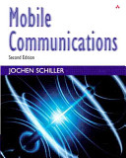

Exams and Grading
Midterm: 30%
Final: 40%
Assignments: 30%
Text Book (required):
Text Book (supplementary):

Slide 3
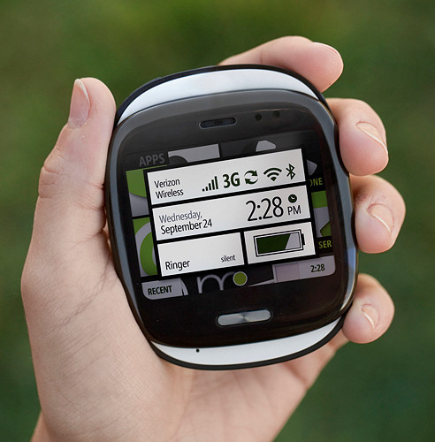
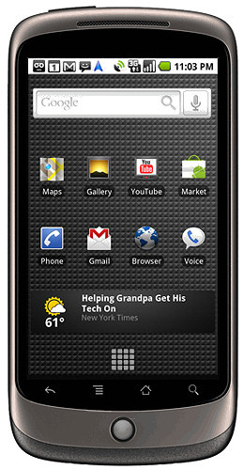
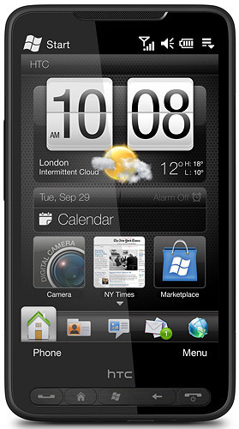
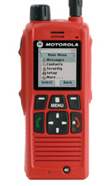
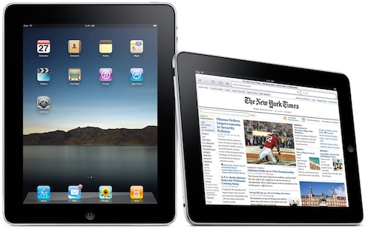
Why Mobile Communications?
Largest SW/HW/networked system
Largest number of subscribers
Mobile devices dominate the Internet
Mobile applications dominate Internet
usage
New possibilities, new threats
Technology fully integrated into everybody's life almost 24/7, almost anywhere

Slide 4
Overview of the lecture (tentative)
  Introduction
    Use-cases, applications
    Definition of terms
    Challenges, history
  Wireless Transmission
    Frequencies & regulations, Cognitive Radio
    Signals, antennas, signal propagation, MIMO
    Multiplexing, modulation, spread spectrum, cellular system, SDR
  Medium Access
    SDMA, FDMA, TDMA, CDMA
    CSMA/CA, versions of Aloha
    Collision avoidance, polling
  Wireless Telecommunication Systems
    GSM, HSCSD, GPRS, DECT, TETRA, UMTS, IMT-2000, LTE
  Satellite Systems
    GEO, LEO, MEO, routing, handover
  Wireless LANs
    Basic Technology
    IEEE 802.11a/b/g/…, .15, Bluetooth, ZigBee
  Network Protocols
    Mobile IP
    Ad-hoc networking
    Routing
  Transport Protocols
    Reliable transmission
    Flow control
    Quality of Service
  Support for Mobility
    File systems, WWW, WAP, i-mode, J2ME, ...
  Game Theory
    GT Applications in Wireless Networks

Slide 5
Mobile Communications
Chapter 1: Introduction
A case for mobility – many aspects
History of mobile communication
Market
Areas of research

Slide 6
Computers for the next decades?
Computers are integrated (95% embedded systems!)
  small, cheap, portable, replaceable - no more separate devices
Technology is in the background
  computer are aware of their environment and adapt (“location awareness”)
  computer recognize the location of the user and react appropriately (e.g., call forwarding, fax forwarding, “context awareness”))
Advances in technology
  more computing power in smaller devices
  flat, lightweight displays with low power consumption
  new user interfaces due to small dimensions
  more bandwidth per cubic meter
  multiple wireless interfaces: wireless LANs, wireless WANs, regional wireless telecommunication networks etc. („overlay networks“)

Slide 7
Wireless communication and mobility
Aspects of mobility:
  user mobility: users communicate “anytime, anywhere, with anyone”
  device portability: devices can be connected anytime, anywhere to the network
Wireless vs. mobile Examples
✗ ✗ stationary computer (desktop)
✗ ✓ notebook in a hotel
✓ ✗ wireless LANs in historic buildings
✓ ✓ Personal Digital Assistant (PDA)
The demand for mobile communication creates the need for integration of wireless networks or mobility mechanisms into existing fixed networks:
  telephone network ➔ cellular telephony (e.g., GSM, UMTS, LTE)
  local area networks ➔ Wireless LANs (e.g., IEEE 802.11 or “WiFi”)
  Internet ➔ Mobile IP

Slide 8
Applications I
Person to person communication (e.g., voice, SMS)
Person to server (e.g., location-based services, timetable consultation, telebanking)
Vehicles
  transmission of news, road condition, weather, music via DAB/DVB-T
  personal communication using GSM/UMTS/LTE
  position via GPS
  local ad-hoc network with vehicles close-by to prevent accidents, guidance system, redundancy
  vehicle data (e.g., from busses, high-speed trains) can be transmitted in advance for maintenance
Emergencies
  early transmission of patient data to the hospital, current status, first diagnosis
  replacement of a fixed infrastructure in case of earthquakes, hurricanes, fire etc.
  crisis, war, ...

Slide 9
Typical application: road traffic
UMTS, WLAN,
DAB, DVB, GSM,
cdma2000, TETRA, ...
ad hoc
Personal Travel Assistant,
PDA, Laptop,
GSM, UMTS, WLAN,
Bluetooth, ...

Slide 10
Mobile and wireless services – Always Best Connected
UMTS, GSM
115 kbit/s
LAN
100 Mbit/s,
WLAN
54 Mbit/s
DSL/ WLAN
3 Mbit/s
GSM/GPRS 53 kbit/s
Bluetooth 500 kbit/s
UMTS
2 Mbit/s
GSM/EDGE 384 kbit/s,
DSL/WLAN 3 Mbit/s
UMTS, GSM
384 kbit/s
GSM 115 kbit/s,
WLAN 11 Mbit/s

Slide 11
Applications II
Traveling salesmen
  direct access to customer files stored in a central location
  consistent databases for all agents
  mobile office
Replacement of fixed networks
  remote sensors, e.g., weather, earth activities
  flexibility for trade shows
  LANs in historic buildings
Entertainment, education, ...
  outdoor Internet access
  intelligent travel guide with up-to-date
  location dependent information
  ad-hoc networks for
  multi user games
History
Info

Slide 12
Location dependent services
Location aware services
  what services, e.g., printer, fax, phone, server etc. exist in the local environment
Follow-on services
  automatic call-forwarding, transmission of the actual workspace to the current location
Information services
  “push”: e.g., current special offers in the supermarket
  “pull”: e.g., where is the Black Forrest Cheese Cake?
Support services
  caches, intermediate results, state information etc. “follow” the mobile device through the fixed network
Privacy
  who should gain knowledge about the location

Slide 13
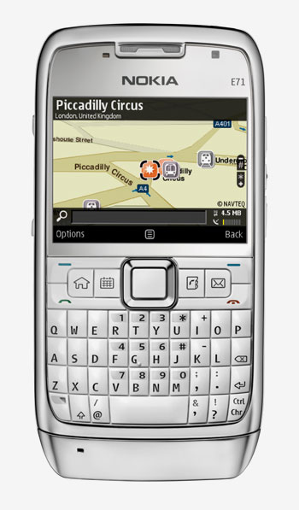
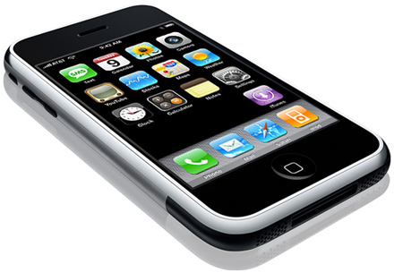
Modern mobile phones
Quad band GSM
(850, 900, 1800, 1900 MHz)
GPRS/EDGE
Tri band UMTS/HSDPA
(850, 1900, 2100 MHz)
GPS + accelerometers
WiFi (802.11b/g/a/n)
Bluetooth 2.1
iPhone
Notes:
13

Slide 14
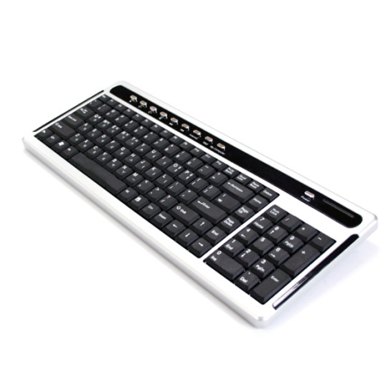
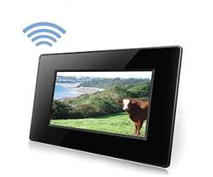
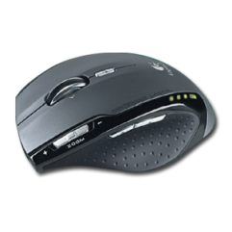
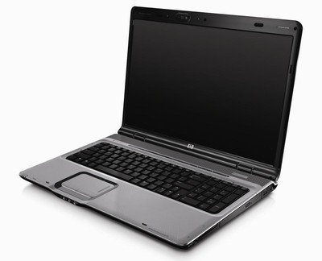
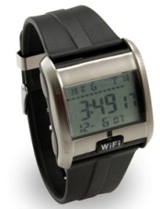
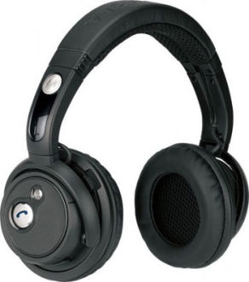
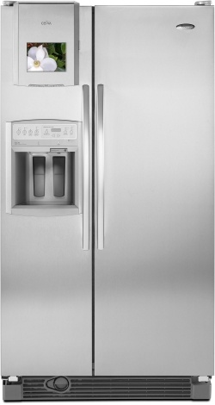
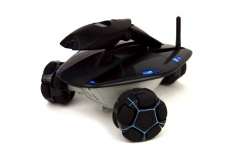
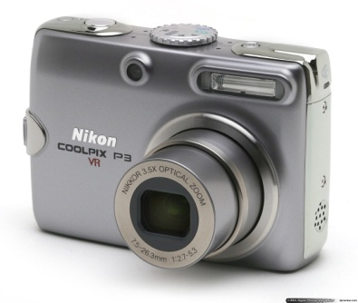
Wireless enabled devices
Notes:
14

Slide 15
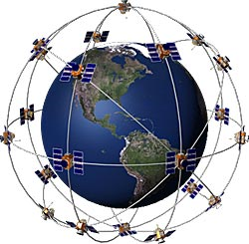
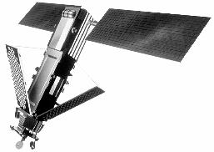
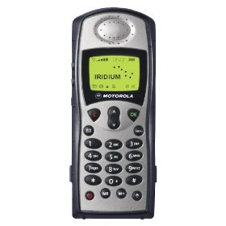
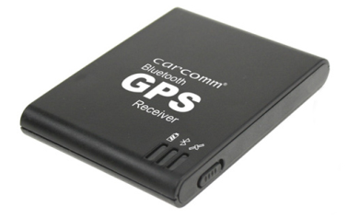
Satellite Communications
Iridium Satellite
Global Positioning System (GPS)
30 satellites currently
Orbit altitude: approx. 20,200 km
Frequency: 1575.42 MHz (L1)
Bit-rate: 50 bps
CDMA
Supports 1100 concurrent phone calls
Orbit altitude: approx. 780 km
Frequency band: 1616-1626.5 MHz
Rate: 25 kBd
FDMA/TDMA
BTCC-45 Bluetooth GPS Receiver
European attempt: Galileo
Iridium 9505A Satellite Phone
Notes:
15

Slide 16
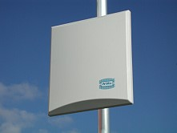

Wireless “Last Mile”: WiMax
WiMAX GP3500-12 omnidirectional antenna
Frequency band: 3400-3600 MHz
Gain: 12 dBi
Impendence: 50 Ω
Power rating: 10 Watt
Vertical beamwidth: 10°
WiMAX PA3500-18 directional antenna
Frequency band: 3200-3800 MHz
Gain: 12 dBi
Impendence: 50 Ω
Power rating: 10 Watt
Vertical beamwidth: 17°
Horizontal beamwidth: 20°
Notes:
16

Slide 17
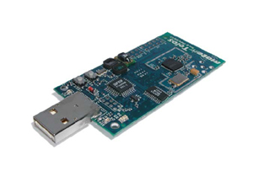
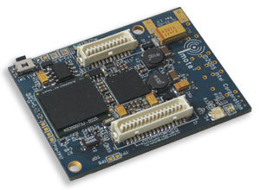
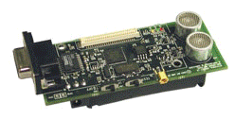
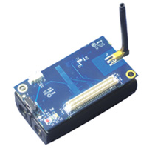
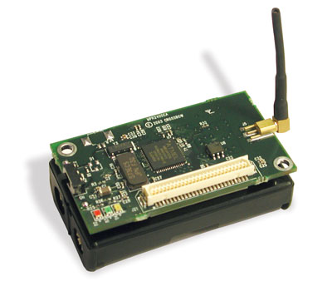
Wireless sensors
Imote2
Cricket Mote
TelosB Sensor Mote
Iris Mote
IEEE 802.15.4 Chipcon Wireless Transceiver
Frequency band: 2.4 to 2.4835 GHz
Data rate: 250 kbps
RF power: -24 dBm to 0 dBm
Receive Sensitivity: -90 dBm (min), -94 dBm (typ)
Range (onboard antenna): 50m indoors / 125m ourdoors
MicaZ
Notes:
17

Slide 18
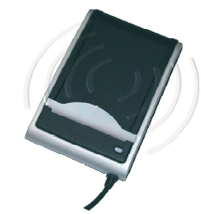
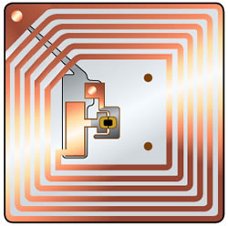
Radio-frequency Identification (RFID)
SDI 010 RFID Reader
ISO14443-A and B (13.56 MHz)
Operating distance: 1cm
Communication speed: up to 848 Kbit/s
RFID tag
Notes:
18

Slide 19
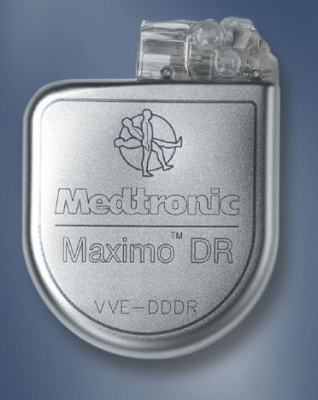
Medical Implants
Implantable Cardioverter Defibrillator (ICD)
Operating frequency: 175kHz
Range: few centimeters
Medical Implant Communication Service (MICS)
Frequency band: 402-405 MHz
Maximum transmit power (EIRP): 25 microwatt
Range: few meters
Notes:
19

Slide 20
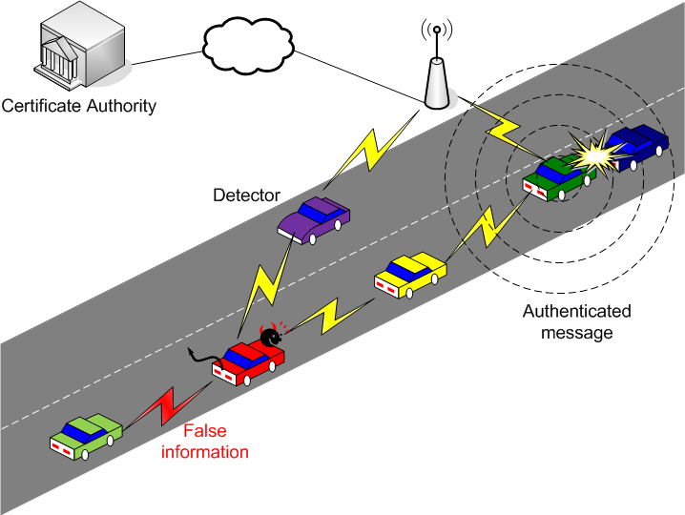
Vehicular communications
Dedicated short-range communications (DSRC)
Frequency band (US): 5.850 to 5.925 GHz
Data rate: 6 to 27 Mbps
Range: up to 1000m
20
Notes:
20

Slide 21
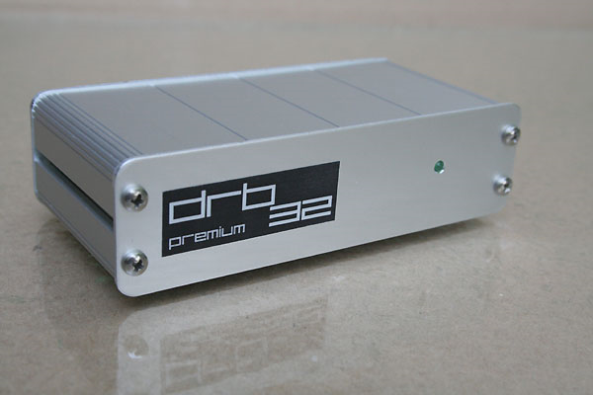
Software Defined Radio
Tuning Frequency:
30KHz - 30MHz (continuous)
Tuning Steps:
1/5/10/50/100/500Hz & 1/5/9/10KHz
Antenna Jacket / Impedance:
BNC-socket / 50Ohms
Max. Allowed Antenna Level :
+10dBm typ. / saturation at -15dBm typ.
Noise Floor (0.15-30MHz BW 2.3KHz):
Standard: < -131dBm (0.06μV) typ.
HighIP: < -119dBm (0.25μV) typ.
Frequency Stability (15min. warm-up
period):
+/- 1ppm typ.
Application: Cognitive Radios ➔ Dynamic Spectrum Access
Notes:
21

Slide 22
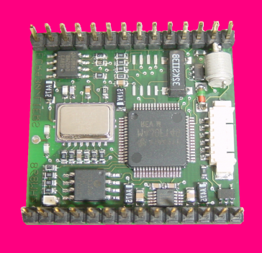
Mobile devices
Pager
receive only
tiny displays
simple text
messages
PDA
graphical displays
character recognition
simplified WWW
Laptop/Notebook
fully functional
standard applications
Sensors,
embedded
controllers
Smartphone
tiny keyboard
simple versions
of standard applications
Mobile phones
voice, data
simple graphical displays
performance
No clear separation between device types possible
(e.g. smart phones, embedded PCs, …)

Slide 23
Effects of device portability
Power consumption
  limited computing power, low quality displays, small disks due to limited battery capacity
  CPU: power consumption ~ CV²f
    C: internal capacity, reduced by integration
    V: supply voltage, can be reduced to a certain limit
    f: clock frequency, can be reduced temporally
Loss of data
  higher probability, has to be included in advance into the design (e.g., defects, theft)
Limited user interfaces
  compromise between size of fingers and portability
  integration of character/voice recognition, abstract symbols
Limited memory (always in relation to e.g. PCs)
  limited usage of mass memories with moving parts
  flash-memory or ? as alternative

Slide 24
Wireless networks in comparison to fixed networks
Higher loss-rates due to interference
  emissions of, e.g., engines, lightning
Restrictive regulations of frequencies
  frequencies have to be coordinated, useful frequencies are almost all occupied
Lower transmission rates
  local some Mbit/s, regional currently, e.g., 53kbit/s with GSM/GPRS or about 150 kbit/s using EDGE – soon Mbit/s with LTE
Higher delays, higher jitter
  connection setup time with GSM in the second range, several hundred milliseconds for other wireless systems – soon in ms range with LTE
Lower security, simpler active attacking
  radio interface accessible for everyone, base station can be simulated, thus attracting calls from mobile phones
Always shared medium
  secure access mechanisms important

Slide 25
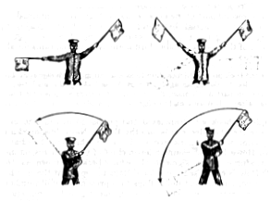
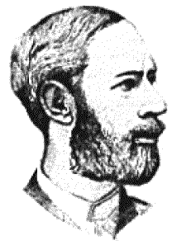
Early history of wireless communication
Many people in history used light for communication
  heliographs, flags (“semaphore”), ...
  150 BC smoke signals for communication;
  (Polybius, Greece)
  1794, optical telegraph, Claude Chappe
Here electromagnetic waves are
of special importance:
  1831 Faraday demonstrates electromagnetic induction
  J. Maxwell (1831-79): theory of electromagnetic Fields, wave equations (1864)
  H. Hertz (1857-94): demonstrates
  with an experiment the wave character
  of electrical transmission through space
  (1888, in Karlsruhe, Germany)

Slide 26
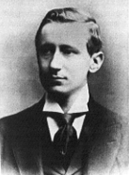
History of wireless communication I
1896 Guglielmo Marconi
  first demonstration of wireless
  telegraphy (digital!)
  long wave transmission, high
  transmission power necessary (> 200kW)
1907 Commercial transatlantic connections
  huge base stations
  (30 100m high antennas)
1915 Wireless voice transmission New York - San Francisco
1920 Discovery of short waves by Marconi
  reflection at the ionosphere
  smaller sender and receiver, possible due to the invention of the vacuum tube (1906, Lee DeForest and Robert von Lieben)
1926 Train-phone on the line Hamburg - Berlin
  wires parallel to the railroad track

Slide 27
History of wireless communication II
1928 Many TV broadcast trials (across Atlantic, color TV, TV news)
1933 Frequency modulation (E. H. Armstrong)
1946 First public mobile telephone service in 25 US cities (1 antenna per city…)
1976 Bell Mobile Phone service for NY city
1979 NMT at 450MHz (Scandinavian countries)
1982 Start of GSM-specification
  goal: pan-European digital mobile phone system with roaming
1983 Start of the American AMPS (Advanced Mobile Phone System, analog)
1984 CT-1 standard (Europe) for cordless telephones
1992 Deployment of GSM
2002 Deployment of UMTS
2010 LTE standards mature, first trials

Slide 28
Wireless systems: development over the last 25 years
cellular phones
satellites
cordless
phones
wireless LAN
1980:
CT0
1981:
NMT 450
1982:
Inmarsat-A
1983:
AMPS
1984:
CT1
1986:
NMT 900
1987:
CT1+
1988:
Inmarsat-C
1989:
CT 2
1991:
CDMA
1991:
D-AMPS
1991:
DECT
1992:
GSM
1992:
Inmarsat-B
Inmarsat-M
199x:
proprietary
1993:
PDC
1994:
DCS 1800
2005:
VoIP-DECT
1997:
IEEE 802.11
1998:
Iridium
1999:
802.11b, Bluetooth
analog
2000:
GPRS
2000:
IEEE 802.11a,g
2001:
UMTS/IMT-2000
CDMA-2000 (USA)
digital
2009:
IEEE 802.11n
2010
LTE
2010
UMA
NMT: Nordic Mobile Telephone DECT: Digital Enhanced Cordless Telecom.
AMPS: Advanced Mobile Phone System (USA) DCS: Digital Cellular System
CT: Cordless Telephone PDC: Pacific Digital Cellular
UMTS: Universal Mobile Telecom. System PAN: Personal Area Network
LTE: Long Term Evolution UMA: Universal Mobile Access

Slide 29
Worldwide wireless subscribers
(old prediction 1998)
700
600
500
Americas
400
Europe
Japan
300
others
total
200
100
0
1996
1997
1998
1999
2000
2001

Slide 30
Mobile phones per 100 people 1999
Germany
Greece
Spain
Belgium
France
Netherlands
Great Britain
Switzerland
Ireland
Austria
Portugal
Luxemburg
Italy
Denmark
Norway
Sweden
Finland
0
10
20
30
40
50
60
2005: 70-90% penetration in Western Europe, 2009 (ten years later): > 100%!

Slide 31
Worldwide cellular subscriber growth
Note that the curve starts to flatten in 2000 – 2010: over 4.5 billion subscribers!

Slide 32
Cellular subscribers per region (September 2009)
www.gsmworld.com

Slide 33
Cellular subscribers in % per technology
www.gsmworld.com

Slide 34
Mobile statistics snapshots (09/2002 / 12/2004 / 04/2006 / Q4/2007
Total Global Mobile Users
869M / 1.52G / 2G / 3.3G
Total Analogue Users 71M / 34M / 1M
Total US Mobile users 145M / 140M
Total Global GSM users 680M / 1.25G 1.5G / 2.7G
Total Global CDMA Users 127M / 202M
Total TDMA users 84M / 120M
Total European users 283M / 343M
Total African users 18.5M / 53M / 83M
Total 3G users 130M / 130M
Total South African users 13.2M / 19M / 30M
European Prepaid Penetration 63%
European Mobile Penetration 70.2%
Global Phone Shipments 2001 393M / 1G 2008
Global Phone Sales 2Q02 96.7M
www.cellular.co.za/stats/
stats-main.htm
www.gsmworld.com
#1 Mobile Country China (139M / 300M)
#1 GSM Country China (99M / 282M / 483M)
#1 SMS Country Philipines
#1 Handset Vendor 2Q02 Nokia (37.2%)
#1 Network In Africa Vodacom (6.6M / 11M)
#1 Network In Asia Unicom (153M)
#1 Network In Japan DoCoMo
#1 Network In Europe T-Mobile (22M / 28M)
#1 In Infrastructure Ericsson
SMS Sent Globally 1Q 60T / 135G / 235G / 650 G
SMS sent in UK 6/02 1.3T / 2.1G
SMS sent Germany 1Q02 5.7T
GSM Countries on Air 171 / 210 / 220
GSM Association members 574 / 839
Total Cost of 3G Licenses in Europe 110T€
SMS/month/user 36
The figures vary a lot depending on the statistic, creator of the statistic etc.!

Slide 35
Areas of research in mobile communication
Wireless Communication
  transmission quality (bandwidth, error rate, delay)
  modulation, coding, interference
  media access, regulations
  ...
Mobility
  location dependent services
  location transparency
  quality of service support (delay, jitter, security)
  ...
Portability
  power consumption
  limited computing power, sizes of display, ...
  usability
  ...

Slide 36
Simple reference model used here
Application
Application
Transport
Transport
Network
Network
Network
Network
Data Link
Data Link
Data Link
Data Link
Physical
Physical
Physical
Physical
Radio
Medium

Slide 37
Influence of mobile communication to the layer model
Application layer
Transport layer
Network layer
Data link layer
Physical layer
service location
new/adaptive applications
multimedia
congestion/flow control
quality of service
addressing, routing
device location
hand-over
authentication
media access/control
multiplexing
encryption
modulation
interference
attenuation
frequency

Slide 38
Overview of the main chapters
Chapter 10:
Support for Mobility
Chapter 9:
Mobile Transport Layer
Chapter 8:
Mobile Network Layer
Chapter 4:
Telecommunication
Systems
Chapter 5:
Satellite
Systems
Chapter 6:
Broadcast
Systems
Chapter 7:
Wireless
LAN
Chapter 3:
Medium Access Control
Chapter 2:
Wireless Transmission

Slide 39
Overlay Networks - the global goal
integration of heterogeneous fixed and
mobile networks with varying
transmission characteristics
regional
vertical
handover
metropolitan area
campus-based
horizontal
handover
in-house

