Slide 1
Mobile Communications
Chapter 7: Wireless LANs
Characteristics
IEEE 802.11 (PHY, MAC, Roaming, .11a, b, g, h, i, n … z)
Bluetooth / IEEE 802.15.x
IEEE 802.16/.20/.21/.22
RFID
Comparison

Slide 2
Mobile Communication Technology according to IEEE (examples)
WiFi
Local wireless networks
WLAN 802.11
802.11a
802.11h
802.11i/e/…/n/…/z/aa
802.11b
802.11g
ZigBee
Personal wireless nw
WPAN 802.15
802.15.4
802.15.4a/b/c/d/e/f/g
802.15.5, .6 (WBAN)
802.15.2
802.15.3
802.15.3b/c
802.15.1
Bluetooth
Wireless distribution networks
WMAN 802.16 (Broadband Wireless Access)
WiMAX
+ Mobility
[802.20 (Mobile Broadband Wireless Access)]
802.16e (addition to .16 for mobile devices)

Slide 3
Characteristics of wireless LANs
Advantages
  very flexible within the reception area
  Ad-hoc networks without previous planning possible
  (almost) no wiring difficulties (e.g. historic buildings, firewalls)
  more robust against disasters like, e.g., earthquakes, fire - or users pulling a plug...
Disadvantages
  typically very low bandwidth compared to wired networks
  (1-10 Mbit/s) due to shared medium
  many proprietary solutions, especially for higher bit-rates, standards take their time (e.g. IEEE 802.11n)
  products have to follow many national restrictions if working wireless, it takes a vary long time to establish global solutions like, e.g., IMT-2000

Slide 4
Design goals for wireless LANs
global, seamless operation
low power for battery use
no special permissions or licenses needed to use the LAN
robust transmission technology
simplified spontaneous cooperation at meetings
easy to use for everyone, simple management
protection of investment in wired networks
security (no one should be able to read my data), privacy (no one should be able to collect user profiles), safety (low radiation)
transparency concerning applications and higher layer protocols, but also location awareness if necessary
…

Slide 5
Comparison: infrared vs. radio transmission
Infrared
  uses IR diodes, diffuse light, multiple reflections (walls, furniture etc.)
Advantages
  simple, cheap, available in many mobile devices
  no licenses needed
  simple shielding possible
Disadvantages
  interference by sunlight, heat sources etc.
  many things shield or absorb IR light
  low bandwidth
Example
  IrDA (Infrared Data Association) interface available everywhere
Radio
  typically using the license free ISM band at 2.4 GHz
Advantages
  experience from wireless WAN and mobile phones can be used
  coverage of larger areas possible (radio can penetrate walls, furniture etc.)
Disadvantages
  very limited license free frequency bands
  shielding more difficult, interference with other electrical devices
Example
  Many different products

Slide 6
Comparison: infrastructure vs. ad-hoc networks
infrastructure
network
AP: Access Point
AP
AP
wired network
AP
ad-hoc network

Slide 7
802.11 - Architecture of an infrastructure network
Station (STA)
  terminal with access mechanisms to the wireless medium and radio contact to the access point
Basic Service Set (BSS)
  group of stations using the same radio frequency
Access Point
  station integrated into the wireless LAN and the distribution system
Portal
  bridge to other (wired) networks
Distribution System
  interconnection network to form one logical network (EES: Extended Service Set) based
  on several BSS
802.11 LAN
802.x LAN
STA₁
BSS₁
Access
Point
Portal
Distribution System
ESS
Access
Point
BSS₂
STA₂
802.11 LAN
STA₃
Notes:
9

Slide 8
802.11 - Architecture of an ad-hoc network
Direct communication within a limited range
  Station (STA):
  terminal with access mechanisms to the wireless medium
  Independent Basic Service Set (IBSS):
  group of stations using the same radio frequency
802.11 LAN
STA₁
IBSS₁
STA₃
STA₂
IBSS₂
STA₅
STA₄
802.11 LAN

Slide 9
IEEE standard 802.11
fixed
terminal
mobile terminal
infrastructure
network
access point
application
application
TCP
TCP
IP
IP
LLC
LLC
LLC
802.11 MAC
802.11 MAC
802.3 MAC
802.3 MAC
802.11 PHY
802.11 PHY
802.3 PHY
802.3 PHY

Slide 10
802.11 - Layers and functions
MAC
  access mechanisms, fragmentation, encryption
MAC Management
  synchronization, roaming, MIB, power management
PLCP Physical Layer Convergence Protocol
  clear channel assessment signal (carrier sense)
PMD Physical Medium Dependent
  modulation, coding
PHY Management
  channel selection, MIB
Station Management
  coordination of all management functions
Station Management
LLC
DLC
MAC
MAC Management
PLCP
PHY Management
PHY
PMD

Slide 11
802.11 - Physical layer
3 versions: 2 radio: DSSS and FHSS (both typically at 2.4 GHz), 1 IR
  data rates 1, 2, 5 or 11 Mbit/s
DSSS (Direct Sequence Spread Spectrum)
  DBPSK modulation (Differential Binary Phase Shift Keying) or DQPSK (Differential Quadrature PSK)
  chipping sequence: +1, -1, +1, +1, -1, +1, +1, +1, -1, -1, -1 (Barker code)
  max. radiated power 1 W (USA), 100 mW (EU), min. 1mW
FHSS (Frequency Hopping Spread Spectrum)
  spreading, despreading, signal strength
  min. 2.5 frequency hops/s, two-level GFSK modulation (Gaussian Frequency Shift Keying)
Infrared
  850-950 nm, diffuse light, around 10 m range
  carrier detection, energy detection, synchronization

Slide 12
802.11 - MAC layer principles I
Traffic services
  Asynchronous Data Service (mandatory)
    exchange of data packets based on “best-effort”
    support of broadcast and multicast
  Time-Bounded Service (optional)
    implemented using PCF (Point Coordination Function)
Access methods (called DFWMAC: Distributed Foundation Wireless MAC)
  DCF CSMA/CA (mandatory)
    collision avoidance via randomized „back-off“ mechanism
    minimum distance between consecutive packets
    ACK packet for acknowledgements (not for broadcasts)
  DCF with RTS/CTS (optional)
    avoids hidden terminal problem
  PCF (optional)
    access point polls terminals according to a list
DCF: Distributed Coordination Function
PCF: Point Coordination Function

Slide 13
802.11 - MAC layer Principles II
Priorities
  defined through different inter frame spaces
  no guaranteed, hard priorities
  SIFS (Short Inter Frame Spacing)
    highest priority, for ACK, CTS, polling response
  PIFS (PCF IFS)
    medium priority, for time-bounded service using PCF
  DIFS (DCF, Distributed Coordination Function IFS)
    lowest priority, for asynchronous data service
DIFS
DIFS
PIFS
medium busy
SIFS
contention
next frame
t
direct access if
medium is free ≥ DIFS
Note : IFS durations are specific to each PHY

Slide 14
802.11 - CSMA/CA access method I
station ready to send starts sensing the medium (Carrier Sense based on CCA, Clear Channel Assessment)
if the medium is free for the duration of an Inter-Frame Space (IFS), the station can start sending (IFS depends on service type)
if the medium is busy, the station has to wait for a free IFS, then the station must additionally wait a random back-off time (collision avoidance, multiple of slot-time)
if another station occupies the medium during the back-off time of the station, the back-off timer stops (fairness)
DIFS
DIFS
contention window
(randomized back-off
mechanism)
medium busy
next frame
direct access if
medium is free ≥ DIFS
t
slot time (20µs)
Notes:
12

Slide 15
802.11 – CSMA/CA Broadcast
DIFS
DIFS
DIFS
DIFS
bo_{e}
bo_{r}
bo_{e}
bo_{r}
bo_{e}
busy
station₁
bo_{e}
busy
station₂
busy
station₃
bo_{e}
busy
bo_{e}
bo_{r}
station₄
bo_{e}
bo_{r}
bo_{e}
busy
bo_{e}
bo_{r}
station₅
t
Here St4 and St5 happen to have
the same back-off time
busy
medium not idle (frame, ack etc.)
bo_{e}
elapsed backoff time
packet arrival at MAC
bo_{r}
residual backoff time
The size of the contention window can be adapted
(if more collisions, then increase the size)
Note: broadcast is not acknowledged

Slide 16
802.11 - CSMA/CA unicast
Sending unicast packets
  station has to wait for DIFS before sending data
  receivers acknowledge at once (after waiting for SIFS) if the packet was received correctly (CRC)
  automatic retransmission of data packets in case of transmission errors
DIFS
data
sender
SIFS
ACK
receiver
DIFS
other
stations
data
t
waiting time
contention
The ACK is sent right at the end of SIFS
(no contention)

Slide 17
802.11 – DCF with RTS/CTS
Sending unicast packets
  station can send RTS with reservation parameter after waiting for DIFS (reservation determines amount of time the data packet needs the medium)
  acknowledgement via CTS after SIFS by receiver (if ready to receive)
  sender can now send data at once, acknowledgement via ACK
  other stations store medium reservations distributed via RTS and CTS
DIFS
RTS
data
sender
SIFS
SIFS
SIFS
CTS
ACK
receiver
NAV (RTS)
DIFS
other
stations
data
NAV (CTS)
t
defer access
contention
NAV: Net Allocation Vector
RTS/CTS can be present for some packets and not for other

Slide 18
Fragmentation mode
DIFS
RTS
frag₁
frag₂
sender
SIFS
SIFS
SIFS
SIFS
SIFS
CTS
ACK₁
ACK₂
receiver
NAV (RTS)
NAV (CTS)
NAV (frag₁)
DIFS
other
stations
data
NAV (ACK₁)
t
contention
Fragmentation is used in case the size of the packets sent has to be
reduced (e.g., to diminish the probability of erroneous frames)
Each frag_{i} (except the last one) also contains a duration (as RTS does),
which determines the duration of the NAV
By this mechanism, fragments are sent in a row
In this example, there are only 2 fragments

Slide 19
802.11 Point Coordination Function I (almost never used)
t₀
t₁
SuperFrame
medium busy
PIFS
SIFS
SIFS
D₁
D₂
point
coordinator
SIFS
SIFS
U₁
U₂
wireless
stations
stations‘
NAV
NAV
Purpose: provide a time-bounded service
Not usable for ad hoc networks
D_{i} represents the polling of station i
U_{i} represents transmission of data from station i

Slide 20
802.11 Point Coordination Function II
t₂
t₃
t₄
PIFS
SIFS
D₃
D₄
CF_{end}
point
coordinator
SIFS
U₄
wireless
stations
stations‘
NAV
NAV
contention free period
contention
period
t
In this example, station 3 has no data to send

Slide 21
802.11 Frame - addressing
2
2
6
6
6
2
6
0 - 2312
4
frame
control
duration
address
1
address
2
address
3
seq
control
address
4
payload
CRC
Address 4: used only in ad hoc mode
Address 1: MAC address
of wireless host or AP
to receive this frame
Address 3: MAC address
of router interface to which AP is attached
Address 2: MAC address
of wireless host or AP
transmitting this frame

Slide 22
802.11 Frame - addressing
Internet
H1
R1
router
AP
R1 MAC addr H1 MAC addr
dest. address
source address
802.3 frame
AP MAC addr H1 MAC addr R1 MAC addr
address 1
address 2
address 3
802.11 frame

Slide 23
802.11 Frame - more
duration of reserved
transmission time (RTS/CTS)
frame seq #
(for RDT)
2
2
6
6
6
2
6
0 - 2312
4
frame
control
duration
address
1
address
2
address
3
seq
control
address
4
payload
CRC
2
2
4
1
1
1
1
1
1
1
1
Protocol
version
Type
Subtype
To
AP
From
AP
More
frag
Retry
Power
mgt
More
data
WEP
Rsvd
frame type
(RTS, CTS, ACK, data)

Slide 24
Special Frames: ACK, RTS, CTS
Acknowledgement
Request To Send
Clear To Send
bytes
2
2
6
4
ACK
Frame
Control
Duration
Receiver
Address
CRC
bytes
2
2
6
6
4
RTS
Frame
Control
Duration
Receiver
Address
Transmitter
Address
CRC
bytes
2
2
6
4
CTS
Frame
Control
Duration
Receiver
Address
CRC

Slide 25
802.11 - MAC management
Synchronization
  try to find a LAN, try to stay within a LAN
  timer etc.
Power management
  sleep-mode without missing a message
  periodic sleep, frame buffering, traffic measurements
Association/Reassociation
  integration into a LAN
  roaming, i.e. change networks by changing access points
  scanning, i.e. active search for a network
MIB - Management Information Base
  managing, read, write

Slide 26
Synchronization (infrastructure case)
beacon interval
(20ms – 1s)
B
B
B
B
access
point
busy
busy
busy
busy
medium
t
value of the timestamp
B
beacon frame
The access point transmits the (quasi) periodic beacon signal
The beacon contains a timestamp and other management information used for
power management and roaming
All other wireless nodes adjust their local timers to the timestamp

Slide 27
Synchronization (ad-hoc case)
beacon interval
B₁
B₁
station₁
B₂
B₂
station₂
busy
busy
busy
busy
medium
t
value of the timestamp
B
beacon frame
random delay
Each node maintains its own synchronization timer and starts the transmission
of a beacon frame after the beacon interval
Contention ➔ back-off mechanism ➔ only 1 beacon wins
All other stations adjust their internal clock according to the received beacon
and suppress their beacon for the current cycle

Slide 28
Power management
Idea: switch the transceiver off if not needed
States of a station: sleep and awake
Timing Synchronization Function (TSF)
  stations wake up at the same time
Infrastructure
  Traffic Indication Map (TIM)
    list of unicast receivers transmitted by AP
  Delivery Traffic Indication Map (DTIM)
    list of broadcast/multicast receivers transmitted by AP
Ad-hoc
  Ad-hoc Traffic Indication Map (ATIM)
    announcement of receivers by stations buffering frames
    more complicated - no central AP
    collision of ATIMs possible (scalability?)
APSD (Automatic Power Save Delivery)
  new method in 802.11e replacing above schemes

Slide 29
Power saving with wake-up patterns (infrastructure)
Here the access point announces
data addressed to the station
TIM interval
DTIM interval
D
B
T
T
d
D
B
access
point
busy
busy
busy
busy
medium
p
d
station
t
T
TIM
D
DTIM
awake
B
p
d
data transmission
to/from the station
broadcast/multicast
PS poll

Slide 30
Power saving with wake-up patterns (ad-hoc)
ATIM
window
beacon interval
B₁
A
D
B₁
station₁
B₂
B₂
a
d
station₂
t
B
beacon frame
random delay
A
transmit ATIM
D
transmit data
awake
a
acknowledge ATIM
d
acknowledge data
ATIM: Ad hoc Traffic Indication Map (a station announces the list of buffered frames)
Potential problem: scalability (high number of collisions)

Slide 31
802.11 - Roaming
No or bad connection? Then perform:
Scanning
  scan the environment, i.e., listen into the medium for beacon signals or send probes into the medium and wait for an answer
Reassociation Request
  station sends a request to one or several AP(s)
Reassociation Response
  success: AP has answered, station can now participate
  failure: continue scanning
AP accepts Reassociation Request
  signal the new station to the distribution system
  the distribution system updates its data base (i.e., location information)
  typically, the distribution system now informs the old AP so it can release resources
Fast roaming – 802.11r
  e.g. for vehicle-to-roadside networks

Slide 32
WLAN: IEEE 802.11b
Data rate
  1, 2, 5.5, 11 Mbit/s, depending on SNR
  User data rate max. approx. 6 Mbit/s
Transmission range
  300m outdoor, 30m indoor
  Max. data rate ~10m indoor
Frequency
  DSSS, 2.4 GHz ISM-band
Security
  Limited, WEP insecure, SSID
Availability
  Many products, many vendors
Connection set-up time
  Connectionless/always on
Quality of Service
  Typ. Best effort, no guarantees (unless polling is used, limited support in products)
Manageability
  Limited (no automated key distribution, sym. Encryption)
Special Advantages/Disadvantages
  Advantage: many installed systems, lot of experience, available worldwide, free ISM-band, many vendors, integrated in laptops, simple system
  Disadvantage: heavy interference on ISM-band, no service guarantees, slow relative speed only

Slide 33
IEEE 802.11b – PHY frame formats
Long PLCP PPDU format
128
16
8
8
16
16
variable
bits
synchronization
SFD
signal
service
length
HEC
payload
PLCP preamble
PLCP header
192 µs at 1 Mbit/s DBPSK
1, 2, 5.5 or 11 Mbit/s
Short PLCP PPDU format (optional)
56
16
8
8
16
16
variable
bits
short synch.
SFD
signal
service
length
HEC
payload
PLCP preamble
(1 Mbit/s, DBPSK)
PLCP header
(2 Mbit/s, DQPSK)
96 µs
2, 5.5 or 11 Mbit/s

Slide 34
Channel selection (non-overlapping)
Europe (ETSI)
channel 1
channel 7
channel 13
2400
2412
2442
2472
2483.5
22 MHz
[MHz]
US (FCC)/Canada (IC)
channel 1
channel 6
channel 11
2400
2412
2437
2462
2483.5
22 MHz
[MHz]

Slide 35
WLAN: IEEE 802.11a
Data rate
  6, 9, 12, 18, 24, 36, 48, 54 Mbit/s, depending on SNR
  User throughput (1500 byte packets): 5.3 (6), 18 (24), 24 (36), 32 (54)
  6, 12, 24 Mbit/s mandatory
Transmission range
  100m outdoor, 10m indoor
    E.g., 54 Mbit/s up to 5 m, 48 up to 12 m, 36 up to 25 m, 24 up to 30m, 18 up to 40 m, 12 up to 60 m
Frequency
  Free 5.15-5.25, 5.25-5.35, 5.725-5.825 GHz ISM-band
Security
  Limited, WEP insecure, SSID
Availability
  Some products, some vendors
Connection set-up time
  Connectionless/always on
Quality of Service
  Typ. best effort, no guarantees (same as all 802.11 products)
Manageability
  Limited (no automated key distribution, sym. Encryption)
Special Advantages/Disadvantages
  Advantage: fits into 802.x standards, free ISM-band, available, simple system, uses less crowded 5 GHz band
  Disadvantage: stronger shading due to higher frequency, no QoS

Slide 36
IEEE 802.11a – PHY frame format
4
1
12
1
6
16
variable
6
variable
bits
rate
reserved
length
parity
tail
service
payload
tail
pad
PLCP header
PLCP preamble
signal
data
12
1
variable
symbols
6 Mbit/s
6, 9, 12, 18, 24, 36, 48, 54 Mbit/s

Slide 37
Operating channels of 802.11a in Europe
36
40
44
48
52
56
60
64
channel
5150
5180
5200
5220
5240
5260
5280
5300
5320
5350
[MHz]
16.6 MHz
100
104
108
112
116
120
124
128
132
136
140
channel
5470
5500
5520
5540
5560
5580
5600
5620
5640
5660
5680
5700
5725
16.6 MHz
[MHz]
center frequency =
5000 + 5*channel number [MHz]

Slide 38
Operating channels for 802.11a / US U-NII
36
40
44
48
52
56
60
64
channel
5150
5180
5200
5220
5240
5260
5280
5300
5320
5350
[MHz]
16.6 MHz
center frequency =
5000 + 5*channel number [MHz]
149
153
157
161
channel
5725
5745
5765
5785
5805
5825
[MHz]
16.6 MHz

Slide 39
OFDM in IEEE 802.11a
OFDM with 52 used subcarriers (64 in total)
  48 data + 4 pilot
    (plus 12 virtual subcarriers)
  312.5 kHz spacing
pilot
312.5 kHz
-26
-21
-7
-1
1
7
21
26
subcarrier
number
channel center frequency

Slide 40
WLAN: IEEE 802.11 – current developments (06/2009)
802.11c: Bridge Support
  Definition of MAC procedures to support bridges as extension to 802.1D
802.11d: Regulatory Domain Update
  Support of additional regulations related to channel selection, hopping sequences
802.11e: MAC Enhancements – QoS
  Enhance the current 802.11 MAC to expand support for applications with Quality of Service requirements, and in the capabilities and efficiency of the protocol
  Definition of a data flow (“connection”) with parameters like rate, burst, period… supported by HCCA (HCF (Hybrid Coordinator Function) Controlled Channel Access, optional)
  Additional energy saving mechanisms and more efficient retransmission
  EDCA (Enhanced Distributed Channel Access): high priority traffic waits less for channel access
802.11F: Inter-Access Point Protocol (withdrawn)
  Establish an Inter-Access Point Protocol for data exchange via the distribution system
802.11g: Data Rates > 20 Mbit/s at 2.4 GHz; 54 Mbit/s, OFDM
  Successful successor of 802.11b, performance loss during mixed operation with .11b
802.11h: Spectrum Managed 802.11a
  Extension for operation of 802.11a in Europe by mechanisms like channel measurement for dynamic channel selection (DFS, Dynamic Frequency Selection) and power control (TPC, Transmit Power Control)
802.11i: Enhanced Security Mechanisms
  Enhance the current 802.11 MAC to provide improvements in security.
  TKIP enhances the insecure WEP, but remains compatible to older WEP systems
  AES provides a secure encryption method and is based on new hardware

Slide 41
WLAN: IEEE 802.11– current developments (06/2009)
802.11j: Extensions for operations in Japan
  Changes of 802.11a for operation at 5GHz in Japan using only half the channel width at larger range
802.11-2007: Current “complete” standard
  Comprises amendments a, b, d, e, g, h, i, j
802.11k: Methods for channel measurements
  Devices and access points should be able to estimate channel quality in order to be able to choose a better access point of channel
802.11m: Updates of the 802.11-2007 standard
802.11n: Higher data rates above 100Mbit/s
  Changes of PHY and MAC with the goal of 100Mbit/s at MAC SAP
  MIMO antennas (Multiple Input Multiple Output), up to 600Mbit/s are currently feasible
  However, still a large overhead due to protocol headers and inefficient mechanisms
802.11p: Inter car communications
  Communication between cars/road side and cars/cars
  Planned for relative speeds of min. 200km/h and ranges over 1000m
  Usage of 5.850-5.925GHz band in North America
802.11r: Faster Handover between BSS
  Secure, fast handover of a station from one AP to another within an ESS
  Current mechanisms (even newer standards like 802.11i) plus incompatible devices from different vendors are massive problems for the use of, e.g., VoIP in WLANs
  Handover should be feasible within 50ms in order to support multimedia applications efficiently

Slide 42
WLAN: IEEE 802.11– current developments (06/2009)
802.11s: Mesh Networking
  Design of a self-configuring Wireless Distribution System (WDS) based on 802.11
  Support of point-to-point and broadcast communication across several hops
802.11T: Performance evaluation of 802.11 networks
  Standardization of performance measurement schemes
802.11u: Interworking with additional external networks
802.11v: Network management
  Extensions of current management functions, channel measurements
  Definition of a unified interface
802.11w: Securing of network control
  Classical standards like 802.11, but also 802.11i protect only data frames, not the control frames. Thus, this standard should extend 802.11i in a way that, e.g., no control frames can be forged.
802.11y: Extensions for the 3650-3700 MHz band in the USA
802.11z: Extension to direct link setup
802.11aa: Robust audio/video stream transport
802.11ac: Very High Throughput <6Ghz
802.11ad: Very High Throughput in 60 GHz
Note: Not all “standards” will end in products, many ideas get stuck at working group level
Info: www.ieee802.org/11/, 802wirelessworld.com, standards.ieee.org/getieee802/

Slide 43
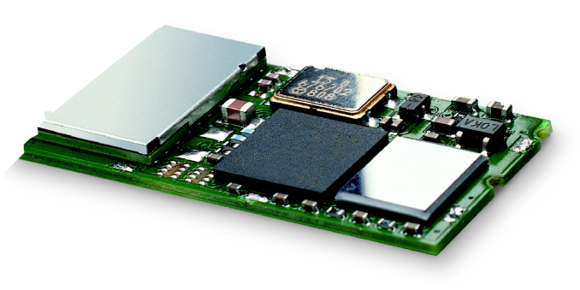
Bluetooth
Basic idea
  Universal radio interface for ad-hoc wireless connectivity
  Interconnecting computer and peripherals, handheld devices, PDAs, cell phones – replacement of IrDA
  Embedded in other devices, goal: 5€/device (already < 1€)
  Short range (10 m), low power consumption, license-free 2.45 GHz ISM
  Voice and data transmission, approx. 1 Mbit/s gross data rate
One of the first modules (Ericsson).

Slide 44

Bluetooth
(was: )
History
  1994: Ericsson (Mattison/Haartsen), “MC-link” project
  Renaming of the project: Bluetooth according to Harald “Blåtand” Gormsen [son of Gorm], King of Denmark in the 10th century
  1998: foundation of Bluetooth SIG, www.bluetooth.org
  1999: erection of a rune stone at Ercisson/Lund ;-)
  2001: first consumer products for mass market, spec. version 1.1 released
  2005: 5 million chips/week
Special Interest Group
  Original founding members: Ericsson, Intel, IBM, Nokia, Toshiba
  Added promoters: 3Com, Agere (was: Lucent), Microsoft, Motorola
  > 10000 members
  Common specification and certification of products

Slide 45

History and hi-tech…
1999:
Ericsson mobile communications AB reste denna sten till minne av Harald Blåtand, som fick ge sitt namn åt en ny teknologi för trådlös, mobil kommunikation.

Slide 46


…and the real rune stone
Located in Jelling, Denmark,
erected by King Harald “Blåtand”
in memory of his parents.
The stone has three sides – one side
showing a picture of Christ.
Inscription:
"Harald king executes these sepulchral monuments after Gorm, his father and Thyra, his mother. The Harald who won the whole of Denmark and Norway and turned the Danes to Christianity."
This could be the “original” colors of the stone.
Inscription:
“auk tani karthi kristna” (and made the Danes Christians)
Btw: Blåtand means “of dark complexion”
(not having a blue tooth…)

Slide 47
Characteristics
2.4 GHz ISM band, 79 (23) RF channels, 1 MHz carrier spacing
  Channel 0: 2402 MHz … channel 78: 2480 MHz
  G-FSK modulation, 1-100 mW transmit power
FHSS and TDD
  Frequency hopping with 1600 hops/s
  Hopping sequence in a pseudo random fashion, determined by a master
  Time division duplex for send/receive separation
Voice link – SCO (Synchronous Connection Oriented)
  FEC (forward error correction), no retransmission, 64 kbit/s duplex, point-to-point, circuit switched
Data link – ACL (Asynchronous ConnectionLess)
  Asynchronous, fast acknowledge, point-to-multipoint, up to 433.9 kbit/s symmetric or 723.2/57.6 kbit/s asymmetric, packet switched
Topology
  Overlapping piconets (stars) forming a scatternet

Slide 48
Piconet
Collection of devices connected in an ad hoc fashion
One unit acts as master and the others as slaves for the lifetime of the piconet
Master determines hopping pattern, slaves have to synchronize
Each piconet has a unique hopping pattern
Participation in a piconet = synchronization to hopping sequence
Each piconet has one master and up to 7 simultaneous slaves (> 200 could be parked)
P
S
S
M
P
SB
S
P
SB
M=Master
S=Slave
P=Parked
SB=Standby

Slide 49
Forming a piconet
All devices in a piconet hop together
  Master gives slaves its clock and device ID
    Hopping pattern: determined by device ID (48 bit, unique worldwide)
    Phase in hopping pattern determined by clock
Addressing
  Active Member Address (AMA, 3 bit)
  Parked Member Address (PMA, 8 bit)


P
•
S


SB
SB
S



M
P
SB




SB
SB
SB
S




SB
SB
P
SB


SB
SB

Slide 50
Scatternet
Linking of multiple co-located piconets through the sharing of common master or slave devices
  Devices can be slave in one piconet and master of another
Communication between piconets
  Devices jumping back and forth between the piconets
Piconets
(each with a
capacity of
720 kbit/s)
P
S
S
S
P
P
M
M
SB
S
M=Master
S=Slave
P=Parked
SB=Standby
P
SB
SB
S

Slide 51
Bluetooth protocol stack
audio apps.
NW apps.
vCal/vCard
telephony apps.
mgmnt. apps.
TCP/UDP
OBEX
AT modem
commands
TCS BIN
SDP
Control
IP
BNEP
PPP
Audio
RFCOMM (serial line interface)
Logical Link Control and Adaptation Protocol (L2CAP)
Host
Controller
Interface
Link Manager
Baseband
Radio
AT: attention sequence
OBEX: object exchange
TCS BIN: telephony control protocol specification – binary
BNEP: Bluetooth network encapsulation protocol
SDP: service discovery protocol
RFCOMM: radio frequency comm.

Slide 52
Frequency selection during data transmission
625 µs
f_{k}
f_{k+1}
f_{k+2}
f_{k+3}
f_{k+4}
f_{k+5}
f_{k+6}
M
S
M
S
M
S
M
t
f_{k}
f_{k+3}
f_{k+4}
f_{k+5}
f_{k+6}
M
S
M
S
M
t
f_{k}
f_{k+1}
f_{k+6}
M
S
M
t

Slide 53
Baseband
Piconet/channel definition
Low-level packet definition
  Access code
    Channel, device access, e.g., derived from master
  Packet header
    1/3-FEC, active member address (broadcast + 7 slaves), link type, alternating bit ARQ/SEQ, checksum
68(72)
54
0-2745
bits
access code
packet header
payload
4
64
(4)
3
4
1
1
1
8
bits
preamble
sync.
(trailer)
AM address
type
flow
ARQN
SEQN
HEC

Slide 54
SCO payload types
payload (30)
HV1
audio (10)
FEC (20)
HV2
audio (20)
FEC (10)
HV3
audio (30)
DV
audio (10)
header (1)
payload (0-9)
2/3 FEC
CRC (2)
(bytes)

Slide 55
ACL Payload types
payload (0-343)
header (1/2)
payload (0-339)
CRC (2)
DM1
header (1)
payload (0-17)
2/3 FEC
CRC (2)
DH1
header (1)
payload (0-27)
CRC (2)
(bytes)
DM3
header (2)
payload (0-121)
2/3 FEC
CRC (2)
DH3
header (2)
payload (0-183)
CRC (2)
DM5
header (2)
payload (0-224)
2/3 FEC
CRC (2)
DH5
header (2)
payload (0-339)
CRC (2)
AUX1
header (1)
payload (0-29)

Slide 56
Baseband data rates
Payload User Symmetric Asymmetric
Header Payload max. Rate max. Rate [kbit/s]
Type [byte] [byte] FEC CRC [kbit/s] Forward Reverse
DM1 1 0-17 2/3 yes 108.8 108.8 108.8
DH1 1 0-27 no yes 172.8 172.8 172.8
DM3 2 0-121 2/3 yes 258.1 387.2 54.4
DH3 2 0-183 no yes 390.4 585.6 86.4
DM5 2 0-224 2/3 yes 286.7 477.8 36.3
DH5 2 0-339 no yes 433.9 723.2 57.6
AUX1 1 0-29 no no 185.6 185.6 185.6
HV1 na 10 1/3 no 64.0
HV2 na 20 2/3 no 64.0
HV3 na 30 no no 64.0
DV 1 D 10+(0-9) D 2/3 D yes D 64.0+57.6 D
ACL
1 slot
3 slot
5 slot
SCO
Data Medium/High rate, High-quality Voice, Data and Voice

Slide 57
Baseband link types
Polling-based TDD packet transmission
  625µs slots, master polls slaves
SCO (Synchronous Connection Oriented) – Voice
  Periodic single slot packet assignment, 64 kbit/s full-duplex, point-to-point
ACL (Asynchronous ConnectionLess) – Data
  Variable packet size (1, 3, 5 slots), asymmetric bandwidth, point-to-multipoint
SCO
ACL
SCO
ACL
SCO
ACL
SCO
ACL
MASTER
f₀
f₄
f₆
f₈
f₁₂
f₁₄
f₁₈
f₂₀
SLAVE 1
f₁
f₇
f₉
f₁₃
f₁₉
SLAVE 2
f₅
f₁₇
f₂₁

Slide 58
Robustness
Slow frequency hopping with hopping patterns determined by a master
  Protection from interference on certain frequencies
  Separation from other piconets (FH-CDMA)
Retransmission
  ACL only, very fast
Forward Error Correction
  SCO and ACL
Error in payload
(not header!)
NAK
ACK
MASTER
A
C
C
F
H
SLAVE 1
B
D
E
SLAVE 2
G
G

Slide 59
Baseband states of a Bluetooth device
standby
unconnected
detach
inquiry
page
connecting
transmit
AMA
connected
AMA
active
park
PMA
hold
AMA
sniff
AMA
low power
Standby: do nothing
Inquire: search for other devices
Page: connect to a specific device
Connected: participate in a piconet
Park: release AMA, get PMA
Sniff: listen periodically, not each slot
Hold: stop ACL, SCO still possible, possibly
participate in another piconet

Slide 60
Example: Power consumption/CSR BlueCore2
Typical Average Current Consumption¹
  VDD=1.8V Temperature = 20°C
  Mode
    SCO connection HV3 (1s interval Sniff Mode) (Slave) 26.0 mA
    SCO connection HV3 (1s interval Sniff Mode) (Master) 26.0 mA
    SCO connection HV1 (Slave) 53.0 mA
    SCO connection HV1 (Master) 53.0 mA
    ACL data transfer 115.2kbps UART (Master) 15.5 mA
    ACL data transfer 720kbps USB (Slave) 53.0 mA
    ACL data transfer 720kbps USB (Master) 53.0 mA
    ACL connection, Sniff Mode 40ms interval, 38.4kbps UART 4.0 mA
    ACL connection, Sniff Mode 1.28s interval, 38.4kbps UART 0.5 mA
    Parked Slave, 1.28s beacon interval, 38.4kbps UART 0.6 mA
    Standby Mode (Connected to host, no RF activity) 47.0 µA
    Deep Sleep Mode² 20.0 µA
Notes:
  ¹ Current consumption is the sum of both BC212015A and the flash.
  ² Current consumption is for the BC212015A device only.

Slide 61
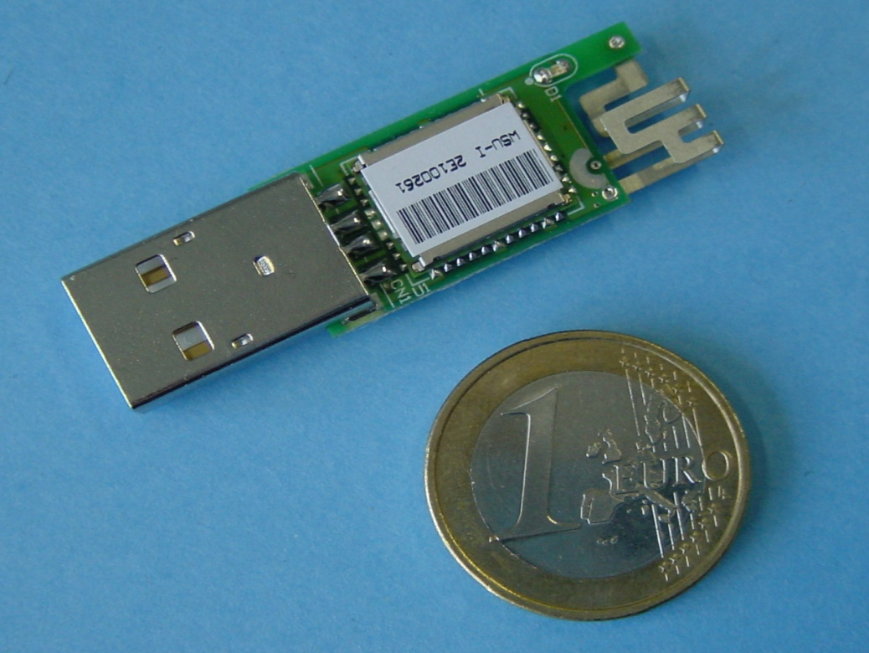
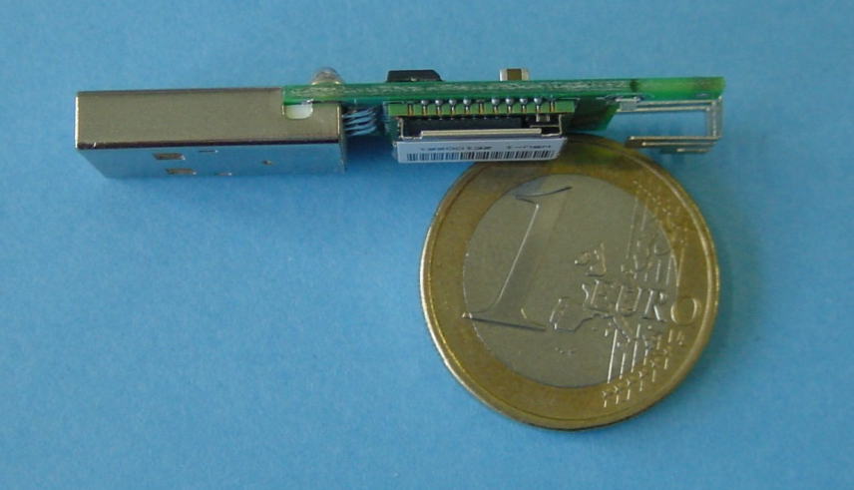
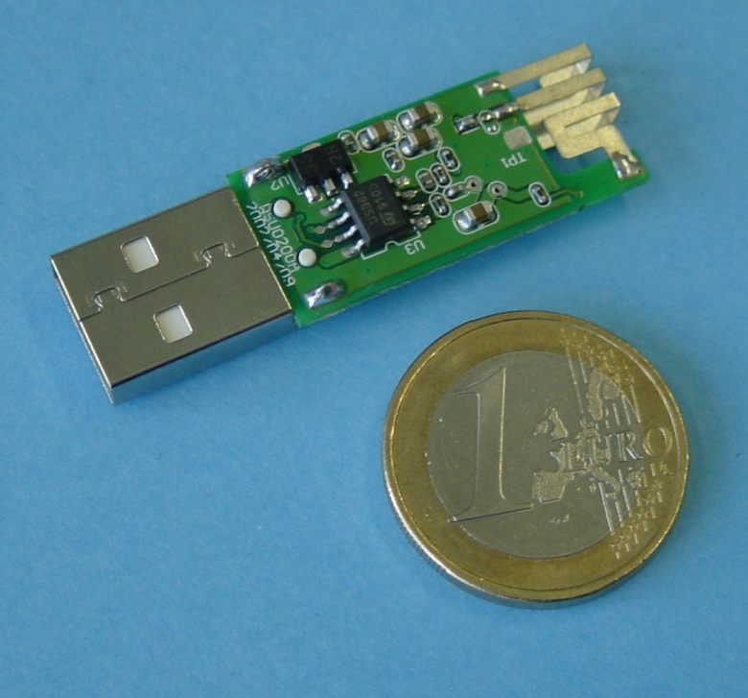
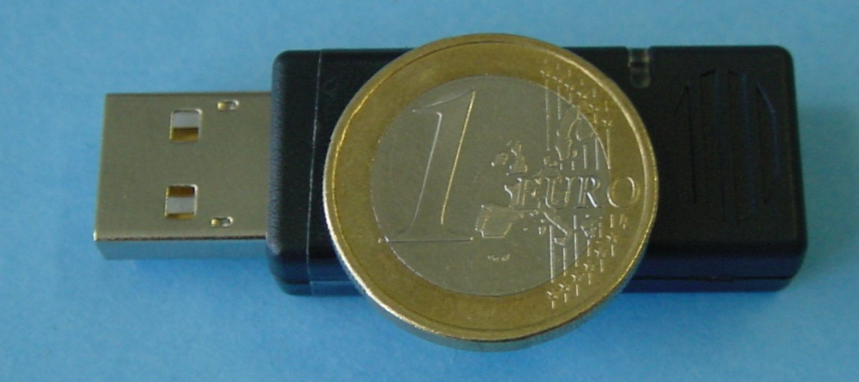
Example: Bluetooth/USB adapter (2002: 50€, today: some cents if integrated)

Slide 62
L2CAP - Logical Link Control and Adaptation Protocol
Simple data link protocol on top of baseband
Connection oriented, connectionless, and signaling channels
Protocol multiplexing
  RFCOMM, SDP, telephony control
Segmentation & reassembly
  Up to 64kbyte user data, 16 bit CRC used from baseband
QoS flow specification per channel
  Follows RFC 1363, specifies delay, jitter, bursts, bandwidth
Group abstraction
  Create/close group, add/remove member

Slide 63
L2CAP logical channels
Slave
Master
Slave
L2CAP
L2CAP
L2CAP
2
d
1
1
d
d
d
d
1
1
d
d
2
baseband
baseband
baseband
signalling
ACL
connectionless
connection-oriented

Slide 64
L2CAP packet formats
Connectionless PDU
2
2
≥2
0-65533
bytes
length
CID=2
PSM
payload
Connection-oriented PDU
2
2
0-65535
bytes
length
CID
payload
Signalling command PDU
2
2
bytes
length
CID=1
One or more commands
1
1
2
≥0
code
ID
length
data

Slide 65
Security
User input (initialization)
PIN (1-16 byte)
Pairing
PIN (1-16 byte)
E₂
Authentication key generation
(possibly permanent storage)
E₂
link key (128 bit)
Authentication
link key (128 bit)
E₃
Encryption key generation
(temporary storage)
E₃
encryption key (128 bit)
Encryption
encryption key (128 bit)
Keystream generator
Keystream generator
payload key
Ciphering
payload key
Cipher data
Data
Data

Slide 66
SDP – Service Discovery Protocol
Inquiry/response protocol for discovering services
  Searching for and browsing services in radio proximity
  Adapted to the highly dynamic environment
  Can be complemented by others like SLP, Jini, Salutation, …
  Defines discovery only, not the usage of services
  Caching of discovered services
  Gradual discovery
Service record format
  Information about services provided by attributes
  Attributes are composed of an 16 bit ID (name) and a value
  values may be derived from 128 bit Universally Unique Identifiers (UUID)

Slide 67
Additional protocols to support legacy protocols/apps.
RFCOMM
  Emulation of a serial port (supports a large base of legacy applications)
  Allows multiple ports over a single physical channel
Telephony Control Protocol Specification (TCS)
  Call control (setup, release)
  Group management
OBEX
  Exchange of objects, IrDA replacement
WAP
  Interacting with applications on cellular phones

Slide 68
Profiles
Represent default solutions for a certain usage model
  Vertical slice through the protocol stack
  Basis for interoperability
Generic Access Profile
Service Discovery Application Profile
Cordless Telephony Profile
Intercom Profile
Serial Port Profile
Headset Profile
Dial-up Networking Profile
Fax Profile
LAN Access Profile
Generic Object Exchange Profile
Object Push Profile
File Transfer Profile
Synchronization Profile
Applications
Protocols
Additional Profiles
Advanced Audio Distribution
PAN
Audio Video Remote Control
Basic Printing
Basic Imaging
Extended Service Discovery
Generic Audio Video Distribution
Hands Free
Hardcopy Cable Replacement
Profiles

Slide 69
Bluetooth versions
Bluetooth 1.1
  also IEEE Standard 802.15.1-2002
  initial stable commercial standard
Bluetooth 1.2
  also IEEE Standard 802.15.1-2005
  eSCO (extended SCO): higher, variable bitrates, retransmission for SCO
  AFH (adaptive frequency hopping) to avoid interference
Bluetooth 2.0 + EDR (2004, no more IEEE)
  EDR (enhanced date rate) of 3.0 Mbit/s for ACL and eSCO
  lower power consumption due to shorter duty cycle
Bluetooth 2.1 + EDR (2007)
  better pairing support, e.g. using NFC
  improved security
Bluetooth 3.0 + HS (2009)
  Bluetooth 2.1 + EDR + IEEE 802.11a/g = 54 Mbit/s

Slide 70
WPAN: IEEE 802.15.1 – Bluetooth
Data rate
  Synchronous, connection-oriented: 64 kbit/s
  Asynchronous, connectionless
    433.9 kbit/s symmetric
    723.2 / 57.6 kbit/s asymmetric
Transmission range
  POS (Personal Operating Space) up to 10 m
  with special transceivers up to 100 m
Frequency
  Free 2.4 GHz ISM-band
Security
  Challenge/response (SAFER+), hopping sequence
Availability
  Integrated into many products, several vendors
Connection set-up time
  Depends on power-mode
  Max. 2.56s, avg. 0.64s
Quality of Service
  Guarantees, ARQ/FEC
Manageability
  Public/private keys needed, key management not specified, simple system integration
Special Advantages/Disadvantages
  Advantage: already integrated into several products, available worldwide, free ISM-band, several vendors, simple system, simple ad-hoc networking, peer to peer, scatternets
  Disadvantage: interference on ISM-band, limited range, max. 8 active devices/network, high set-up latency

Slide 71
WPAN: IEEE 802.15 – future developments 1
802.15.2: Coexistance
  Coexistence of Wireless Personal Area Networks (802.15) and Wireless Local Area Networks (802.11), quantify the mutual interference
802.15.3: High-Rate
  Standard for high-rate (20Mbit/s or greater) WPANs, while still low-power/low-cost
  Data Rates: 11, 22, 33, 44, 55 Mbit/s
  Quality of Service isochronous protocol
  Ad hoc peer-to-peer networking
  Security
  Low power consumption
  Low cost
  Designed to meet the demanding requirements of portable consumer imaging and multimedia applications

Slide 72
WPAN: IEEE 802.15 – future developments 2
Several working groups extend the 802.15.3 standard
802.15.3a: - withdrawn -
  Alternative PHY with higher data rate as extension to 802.15.3
  Applications: multimedia, picture transmission
802.15.3b:
  Enhanced interoperability of MAC
  Correction of errors and ambiguities in the standard
802.15.3c:
  Alternative PHY at 57-64 GHz
  Goal: data rates above 2 Gbit/s
Not all these working groups really create a standard, not all standards will be found in products later …

Slide 73
WPAN: IEEE 802.15 – future developments 3
802.15.4: Low-Rate, Very Low-Power
  Low data rate solution with multi-month to multi-year battery life and very low complexity
  Potential applications are sensors, interactive toys, smart badges, remote controls, and home automation
  Data rates of 20-250 kbit/s, latency down to 15 ms
  Master-Slave or Peer-to-Peer operation
  Up to 254 devices or 64516 simpler nodes
  Support for critical latency devices, such as joysticks
  CSMA/CA channel access (data centric), slotted (beacon) or unslotted
  Automatic network establishment by the PAN coordinator
  Dynamic device addressing, flexible addressing format
  Fully handshaked protocol for transfer reliability
  Power management to ensure low power consumption
  16 channels in the 2.4 GHz ISM band, 10 channels in the 915 MHz US ISM band and one channel in the European 868 MHz band
Basis of the ZigBee technology – www.zigbee.org

Slide 74

ZigBee
Relation to 802.15.4 similar to Bluetooth / 802.15.1
Pushed by Chipcon (now TI), ember, freescale (Motorola), Honeywell, Mitsubishi, Motorola, Philips, Samsung…
More than 260 members
  about 15 promoters, 133 participants, 111 adopters
  must be member to commercially use ZigBee spec
ZigBee platforms comprise
  IEEE 802.15.4 for layers 1 and 2
  ZigBee protocol stack up to the applications

Slide 75
WPAN: IEEE 802.15 – future developments 4
802.15.4a:
  Alternative PHY with lower data rate as extension to 802.15.4
  Properties: precise localization (< 1m precision), extremely low power consumption, longer range
  Two PHY alternatives
    UWB (Ultra Wideband): ultra short pulses, communication and localization
    CSS (Chirp Spread Spectrum): communication only
802.15.4b, c, d, e, f, g:
  Extensions, corrections, and clarifications regarding 802.15.4
  Usage of new bands, more flexible security mechanisms
  RFID, smart utility neighborhood (high scalability)
802.15.5: Mesh Networking
  Partial meshes, full meshes
  Range extension, more robustness, longer battery live
802.15.6: Body Area Networks
  Low power networks e.g. for medical or entertainment use
802.15.7: Visible Light Communication
Not all these working groups really create a standard, not all standards will be found in products later …

Slide 76
Some more IEEE standards for mobile communications
IEEE 802.16: Broadband Wireless Access / WirelessMAN / WiMax
  Wireless distribution system, e.g., for the last mile, alternative to DSL
  75 Mbit/s up to 50 km LOS, up to 10 km NLOS; 2-66 GHz band
  Initial standards without roaming or mobility support
  802.16e adds mobility support, allows for roaming at 150 km/h
IEEE 802.20: Mobile Broadband Wireless Access (MBWA)
  Licensed bands < 3.5 GHz, optimized for IP traffic
  Peak rate > 1 Mbit/s per user
  Different mobility classes up to 250 km/h and ranges up to 15 km
  Relation to 802.16e unclear
IEEE 802.21: Media Independent Handover Interoperability
  Standardize handover between different 802.x and/or non 802 networks
IEEE 802.22: Wireless Regional Area Networks (WRAN)
  Radio-based PHY/MAC for use by license-exempt devices on a non-interfering basis in spectrum that is allocated to the TV Broadcast Service

Slide 77
RF Controllers – ISM bands
Data rate
  Typ. up to 115 kbit/s (serial interface)
Transmission range
  5-100 m, depending on power (typ. 10-500 mW)
Frequency
  Typ. 27 (EU, US), 315 (US), 418 (EU), 426 (Japan), 433 (EU), 868 (EU), 915 (US) MHz (depending on regulations)
Security
  Some products with added processors
Cost
  Cheap: 10€-50€
Availability
  Many products, many vendors
Connection set-up time
  N/A
Quality of Service
  none
Manageability
  Very simple, same as serial interface
Special Advantages/Disadvantages
  Advantage: very low cost, large experience, high volume available
  Disadvantage: no QoS, crowded ISM bands (particularly 27 and 433 MHz), typ. no Medium Access Control, 418 MHz experiences interference with TETRA

Slide 78
RFID – Radio Frequency Identification (1)
Data rate
  Transmission of ID only (e.g., 48 bit, 64kbit, 1 Mbit)
  9.6 – 115 kbit/s
Transmission range
  Passive: up to 3 m
  Active: up to 30-100 m
  Simultaneous detection of up to, e.g., 256 tags, scanning of, e.g., 40 tags/s
Frequency
  125 kHz, 13.56 MHz, 433 MHz, 2.4 GHz, 5.8 GHz and many others
Security
  Application dependent, typ. no crypt. on RFID device
Cost
  Very cheap tags, down to 1€ (passive)
Availability
  Many products, many vendors
Connection set-up time
  Depends on product/medium access scheme (typ. 2 ms per device)
Quality of Service
  none
Manageability
  Very simple, same as serial interface
Special Advantages/Disadvantages
  Advantage: extremely low cost, large experience, high volume available, no power for passive RFIDs needed, large variety of products, relative speeds up to 300 km/h, broad temp. range
  Disadvantage: no QoS, simple denial of service, crowded ISM bands, typ. one-way (activation/ transmission of ID)

Slide 79
RFID – Radio Frequency Identification (2)
Function
  Standard: In response to a radio interrogation signal from a reader (base station) the RFID tags transmit their ID
  Enhanced: additionally data can be sent to the tags, different media access schemes (collision avoidance)
Features
  No line-of sight required (compared to, e.g., laser scanners)
  RFID tags withstand difficult environmental conditions (sunlight, cold, frost, dirt etc.)
  Products available with read/write memory, smart-card capabilities
Categories
  Passive RFID: operating power comes from the reader over the air which is feasible up to distances of 3 m, low price (1€)
  Active RFID: battery powered, distances up to 100 m

Slide 80
RFID – Radio Frequency Identification (3)
Applications
  Total asset visibility: tracking of goods during manufacturing, localization of pallets, goods etc.
  Loyalty cards: customers use RFID tags for payment at, e.g., gas stations, collection of buying patterns
  Automated toll collection: RFIDs mounted in windshields allow commuters to drive through toll plazas without stopping
  Others: access control, animal identification, tracking of hazardous material, inventory control, warehouse management, ...
Local Positioning Systems
  GPS useless indoors or underground, problematic in cities with high buildings
  RFID tags transmit signals, receivers estimate the tag location by measuring the signal‘s time of flight

Slide 81
RFID – Radio Frequency Identification (4)
Security
  Denial-of-Service attacks are always possible
    Interference of the wireless transmission, shielding of transceivers
  IDs via manufacturing or one time programming
  Key exchange via, e.g., RSA possible, encryption via, e.g., AES
Future Trends
  RTLS: Real-Time Locating System – big efforts to make total asset visibility come true
  Integration of RFID technology into the manufacturing, distribution and logistics chain
  Creation of „electronic manifests“ at item or package level (embedded inexpensive passive RFID tags)
  3D tracking of children, patients

Slide 82
RFID – Radio Frequency Identification (5)
Relevant Standards
  American National Standards Institute
    ANSI, www.ansi.org, www.aimglobal.org/standards/rfidstds/ANSIT6.html
  Automatic Identification and Data Capture Techniques
    JTC 1/SC 31, www.uc-council.com/sc31/home.htm, www.aimglobal.org/standards/rfidstds/sc31.htm
  European Radiocommunications Office
    ERO, www.ero.dk, www.aimglobal.org/standards/rfidstds/ERO.htm
  European Telecommunications Standards Institute
    ETSI, www.etsi.org, www.aimglobal.org/standards/rfidstds/ETSI.htm
  Identification Cards and related devices
    JTC 1/SC 17, www.sc17.com, www.aimglobal.org/standards/rfidstds/sc17.htm,
  Identification and communication
    ISO TC 104 / SC 4, www.autoid.org/tc104_sc4_wg2.htm, www.aimglobal.org/standards/rfidstds/TC104.htm
  Road Transport and Traffic Telematics
    CEN TC 278, www.nni.nl, www.aimglobal.org/standards/rfidstds/CENTC278.htm
  Transport Information and Control Systems
    ISO/TC204, www.sae.org/technicalcommittees/gits.htm, www.aimglobal.org/standards/rfidstds/ISOTC204.htm

Slide 83
RFID – Radio Frequency Identification (6)
ISO Standards
  ISO 15418
    MH10.8.2 Data Identifiers
    EAN.UCC Application Identifiers
  ISO 15434 - Syntax for High Capacity ADC Media
  ISO 15962 - Transfer Syntax
  ISO 18000
    Part 2, 125-135 kHz
    Part 3, 13.56 MHz
    Part 4, 2.45 GHz
    Part 5, 5.8 GHz
    Part 6, UHF (860-930 MHz, 433 MHz)
  ISO 18047 - RFID Device Conformance Test Methods
  ISO 18046 - RF Tag and Interrogator Performance Test Methods

Slide 84

ISM band interference
OLD
Many sources of interference
  Microwave ovens, microwave lighting
  802.11, 802.11b, 802.11g, 802.15, …
  Even analog TV transmission, surveillance
  Unlicensed metropolitan area networks
  …
Levels of interference
  Physical layer: interference acts like noise
    Spread spectrum tries to minimize this
    FEC/interleaving tries to correct
  MAC layer: algorithms not harmonized
    E.g., Bluetooth might confuse 802.11
NEW
© Fusion Lighting, Inc., now used by LG as Plasma Lighting System

Slide 85
802.11 vs.(?) 802.15/Bluetooth
Bluetooth may act like a rogue member of the 802.11 network
  Does not know anything about gaps, inter frame spacing etc.
IEEE 802.15-2 discusses these problems
  Proposal: Adaptive Frequency Hopping
    a non-collaborative Coexistence Mechanism
Real effects? Many different opinions, publications, tests, formulae, …
  Results from complete breakdown to almost no effect
  Bluetooth (FHSS) seems more robust than 802.11b (DSSS)
f [MHz]
2480
802.11b
3 channels
(separated by installation)
1000 byte
ACK
DIFS
SIFS
DIFS
500 byte
ACK
500 byte
ACK
500 byte
DIFS
SIFS
DIFS
SIFS
DIFS
802.15.1
79 channels
(separated by hopping pattern)
100
byte
ACK
100
byte
ACK
100
byte
ACK
100
byte
ACK
100
byte
ACK
DIFS
SIFS
DIFS
SIFS
DIFS
SIFS
DIFS
SIFS
DIFS
SIFS
2402
t

